Slide 1
Student Inclusion in Their IEPs
Transition Network Facilitators:
Margie Blackmore, Kriss Rita, Lon Thornburg

Slide 2
Outcomes
As a part of today’s session, participants will:
Identify options for authentically including students in their IEP process
Leave here with tools to implement inclusion
Notes:
Kriss

Slide 3
Why should we include students in their IEP process?
Notes:
Kriss facilitate: Margie scribe

Slide 4
What are the Challenges of Including Students in Their IEP?
Notes:
Kriss facilitate: Marie scribe
Bring chart paper and markers too!
Student intimidated by adults at round table
Students struggles with Communication and Attentiveness
Student and family reluctance
TIme investment-Draw out chart paper triangle
Check our Expectation
Student intimidated by round table of adults
Students’ struggles with communication, attentiveness
Student reluctance
Family members reluctance
Time investment
Check our expectation

Slide 5
What’s working?
Notes:
Kriss facilitate: Lizzie scribe
Self-determination
Student by in
Students need to know their goals to reach their goals
Learning Advocacy
Raises our expectations

Slide 6
Top 10 ways to include students in thier IEPs
Notes:
Kriss

Slide 7
10. Invitation
Invite Student to the IEP
Student involved in sending invitations
Notes:
Margie Student Invitation to IEP
Evite
Email
Design own flyer

Slide 8
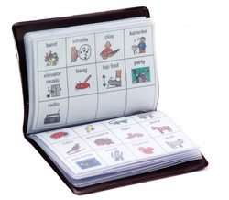
9. Use Augmentative Communication
Notes:
Margie: Use aug-com device just for introductions of team to family (minimal way to include student)
Student leads one portion with aug-com device (pre-programmed)
Strengths, person centered plan, slide with use of switch

Slide 9
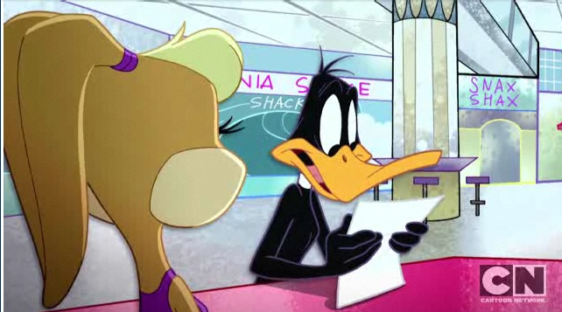
8. Use a script
Create script collaboratively with student
Pre-teach and practice ahead of time
Notes:
Margie: share reference handouts

Slide 10
7. Student Map for Creating Goals
https://www.hdesd.org/?s=sue+
Notes:
Margie-Sue video, student map handout
Share links for downloadable Transition Toolkit

Slide 11
Links:
Sue Hayes Student Map HDESD:
https://www.youtube.com/watch?v=bUbF_BjU5tc
Transition Toolkit TBI:
http://media.cbirt.org/uploads/2012/10/Transition_Toolkit_October_2012.pdf

Slide 12
6. Collaboration in the draft IEP
Student meets with Special Education teacher ahead of time to assist in draft version of IEP
Student and teacher agree to collaboratively lead a portion of the meeting
Notes:
Kriss: Choose one part of the IEP they can feel comfortable collaborating on with you and possibly even leading at the IEP meeting. Accommodations page!

Slide 13
5. Disability Disclosure Tool
http://www.ncwd-youth.info/411-on-disability-disclosure
Notes:
Kriss: share disability 411 tools (bring one 411 to hand out as prize)
Have 411 page open

Slide 14
4. Student Generated SMART Goals
Smart goal templates:
http://www.timvandevall.com/templates/free-smart-goals-template-pdf/
Ipad app: Stretch and Smart Goals: https://itunes.apple.com/us/app/stretch-smart-goals-scientifically/id1104796231?mt=8
Notes:
Kriss: shows students how to interpret our sometimes confusing way of writing goals

Slide 15
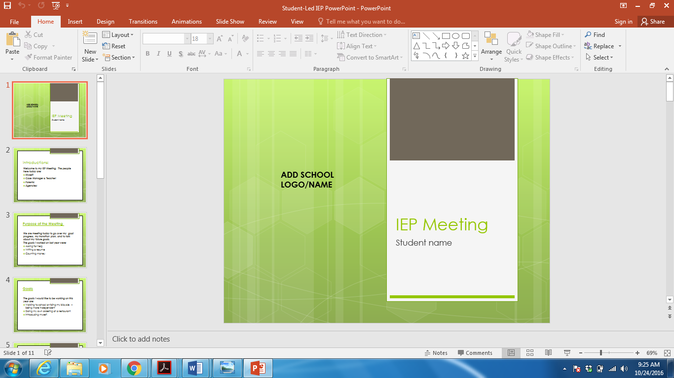
3. Use PowerPoint
Notes:
Kriss
Put in Folder
Teach EA to do this
Pair students who have done this with newbies

Slide 16
2. Use video
Zach https://www.youtube.com/watch?v=Vrz29n8kG_0
Sarah https://www.youtube.com/watch?v=KRhcmx7OXgU
Heather https://www.youtube.com/watch?v=ZlWJILRTNzA
Nathan https://www.youtube.com/watch?v=cUymffXTDBc
Notes:
Kriss add movie trailer program and sample

Slide 17
And the number one way to include students in their IEPs is...

Slide 18
1. One-page profiles
FACT One-Page Profiles: http://factoregon.org/resources/person-centered-plan-samples/
Me Profiles: https://miprofile.ca/profile/5821
http://www.sheffkids.co.uk/adultssite/pages/onepageprofilestemplates.html
Notes:
Margie and Kriss

Slide 19
Pair and Share
Turn to your neighbor and discuss one tool you will start using in the next month…

Slide 20
Questions?? Please complete evaluations Thank You!
Contact:
Margie Blackmore
marguerite.blackmore@hdesd.org
(541) 693-5717
Kriss Rita
krita@clackesd.org
(503) 347-3451
Lon Thornburg lon.Thornburg@imesd.k12.or.us
(541) 966-3162

