Slide 1
Mentoring Best Practices
November 17, 2016
21st Century Community Learning Centers
Center on Educator Preparation and Effectiveness

Slide 2
Mentoring Best Practices
Participants will:
Learn various definitions of mentoring.
Develop understanding about effective mentoring.
Distinguish between formal and informal mentoring.
Gain strategies to mentor staff.

Slide 3

What is mentoring?
  Define mentoring
  Different Mentoring Programs

Slide 4
Define Mentoring
Find 2-3 people
First - Work as a team to define mentoring
Second – Determine the challenges of mentoring

Slide 5

Definitions
As far back as Greek Mythology –
    Someone who helps another person
    Someone who gives advise based on their experience
    Someone who provides guidance
    A Mentor does not evaluate the mentee.

Slide 6
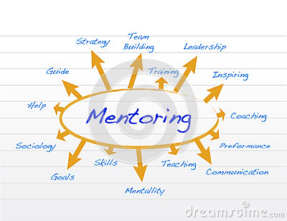

Slide 7
Mentoring Programs
ODE Mentoring Program – involves mentoring beginning educators
College Career Mentoring
ODOT Traffic Safety Program
  New Driver Education Instructors
  New Provider of Driver Education Business
Mentoring Student Employees
And ……….

Slide 8
Mentoring helps:
Attract and retain staff
Develop effective leaders
Increase knowledge sharing
Manage new employees
Improve employee productivity

Slide 9
Why is Mentoring Important?
Assists in effective communication.
Helps mentee to work effectively with others.
Supports effective written communication.
Helps with ethical judgment and decision-making.
Increases critical thinking and reasoning skills.
Assists mentee in real-world settings.

Slide 10
Mentoring improves:
Retention
77% of companies report mentoring programs were effective in increasing retention.
35% of employees who do not receive regular mentoring look for another job within 12 months.

Slide 11
Mentoring improves:
Promotion
75% of executives indicate mentoring played a key role in the careers
44% of CEOs list mentoring as one of the three most effective strategies to enhance women’s advancement
CEOs state that one of the top three factors affecting career growth is mentoring

Slide 12
Mentoring improves:
Productivity
Management productivity increased by 88% when mentoring was involved vs. 24% increase with training alone
71% of Fortune 500 companies use mentoring to ensure learning occurs in their organizations
95% of mentoring participants said the experience motivated them to do their very best

Slide 13
Mentoring assists with….
Development
Over 80% of college and graduate students list mentoring as a criterion for selecting an employer after graduation
96% of executives say mentoring is an important professional development tool

Slide 14
The Difference between Supervisor and Mentor
Supervisor
  Oversight of a person to ensure that a job is performed correctly.
  Check on workflow and job assignments.
Mentor
  A relationship between an experienced professional and a less experienced mentee.

Slide 15

21st CCLC Programs
Mentoring Opportunities
Mentoring new staff
Mentoring students who assist at school
Mentoring students who attend after-school programs
Assisting students who mentor younger students

Slide 16

Mentoring Standards
Recruitment
Screening
Training
Matching and Initiating
Monitoring and Support
Closure
Resources: Elements of Effective Practice for Mentoring
The ABCs of School-Based Mentoring: Effective Strategies for Providing Quality Youth Mentoring in Schools and Communities
Oregon Department of Education: Oregon Mentoring Standards
http://www.ode.state.or.us/search/page/?id=2218

Slide 17


Slide 18
What is Student / Employee Mentoring?
Engaging with students to understand skill level
Providing guidance for success - structured and intentional
Mentoring focuses and motivates students toward
achieving learning goals
IMPORTANT – talk with students/staff 3-4 times a year

Slide 19

“Students are most successful in ‘seamless environments’ where they can make connections between classroom and out of classroom experiences.” George Kuhn

Slide 20
Mentoring New 21st CCLC Staff
After-school programs often have turnover
21st CCLC Modules
Examples of issues to cover and ensure staff is on board
CHALLENGES

Slide 21

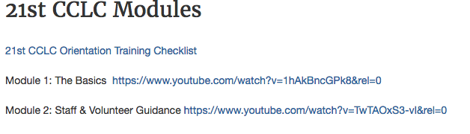

Slide 22
Common Attributes Across Mentoring
  Assisting with:
  Professionalism/Work Ethic
  Oral and Written Communication
  Teamwork/Collaboration
  Critical Thinking/Problem Solving
  Working with others – generational and diversity issues

Slide 23

Questions / Feedback
Working together beats working alone

Slide 24

Mentoring Best Practices
Dr. Christina Reagle
reaglec@wou.edu
503.838.8871
The Research Institute @ Western Oregon University

Slide 25
Thank You!

