Slide 1
JV InvenTeams Workshop
November 17, 2016
Notes:
Greetings and thank you for participating in the JV InvenTeams general webinar today.

Slide 2
Introductions and Agenda
Introductions
Spaghetti Marshmallow Activity
Lemelson-MIT Program
JV InvenTeam Goals
Why Invent?
How it Works
Synopsis of JV Activity Units
Paper Circuit Activity
Deliverables
Feedback from Oregon City
Light Box Activity (if time permits)
How to Apply
Questions
Notes:
Bethany, Don, and Tim can introduce themselves. (Say how you are here representing the Lemelson-MIT Program in Cambridge, MA. Feel free to explain how you are connected to us!)
In this webinar you will have the chance to try-out some fun hands-on invention activities and learn more about JV InvenTeams, an invention program for students in grades 7-10.
(You can read through the bullets on the screen.)

Slide 3
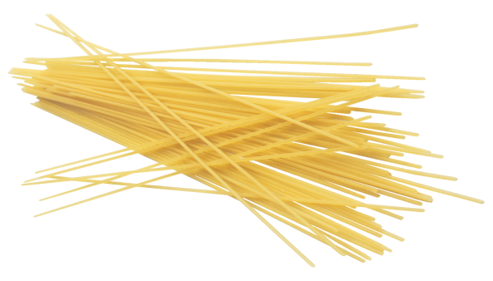
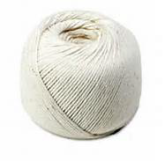
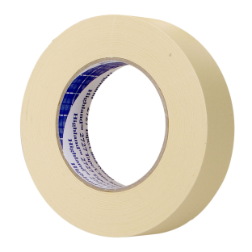

Spaghetti Marshmallow Challenge
Materials:
Pasta
1 yard of tape
1 yard of string
10 small marshmallows
Notes:
We are going to jump right into a fun ice-breaker activity to start the session. Work with at least 1 or 2 other people and follow the instructions on the screen.

Slide 4
Your Task
Build the tallest freestanding tower on the table
Eating the marshmallows disqualifies the team
The team can use as many or as few of the pasta, as much or as little of the string or tape
Use only these materials
Be safe – don’t stand on tables or chairs
Your team has 10 minutes!
Notes:
Don/Bethany/Tim: You can go around the room and have folks share their designs. What worked? What didn’t work? What would you do if you had more time?

Slide 5
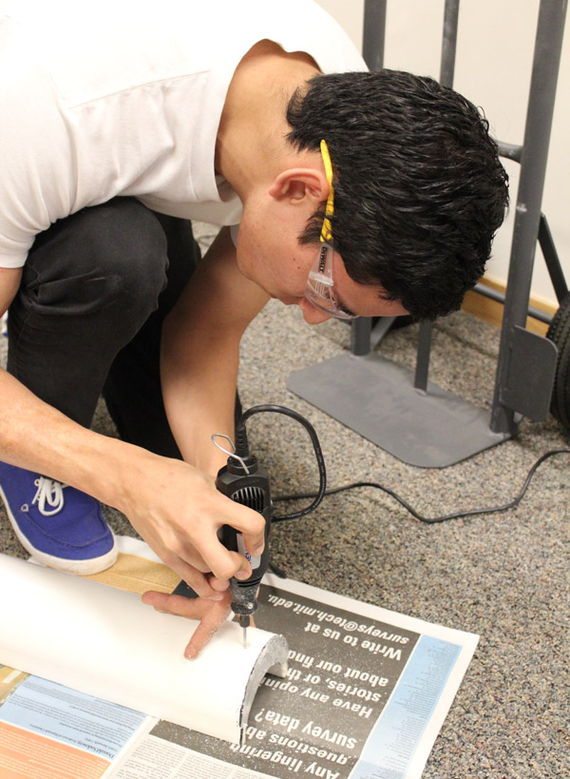
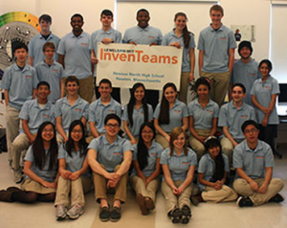
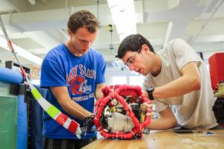
The Lemelson-MIT Program
JV InvenTeams
InvenTeams
Events
http://Lemelson.mit.edu
Invention Education
Notes:
The Lemelson-MIT Program is located within the School of Engineering at MIT in Cambridge, MA. The Program is funded by the Lemelson Foundation, which is based in Portland, Oregon. LMIT inspires the next generation of inventors through a variety of Invention Education initiatives.
(Varsity) InvenTeams is the nation’s premiere invention education initiative, which provides up to $10,000 to teams of students and mentors at high schools to develop a technological solution to a real world problem over the course of an academic year. Each year, Varsity InvenTeams from around the country come to EurekaFest in June to showcase their inventions and get feedback.
JV InvenTeams launched in 2014 to provide high schools students with an initiative to develop their hands-on buildings skills and minds-on inventive thinking skills. Over the course of an academic year, middle school and high school students participate in theme-based activity units to cultivate these skills. Their involvement will prepare them to undertake other STEM competitions like Varsity InvenTeams, eCYBERMISSION, or EPICS projects.

Slide 6
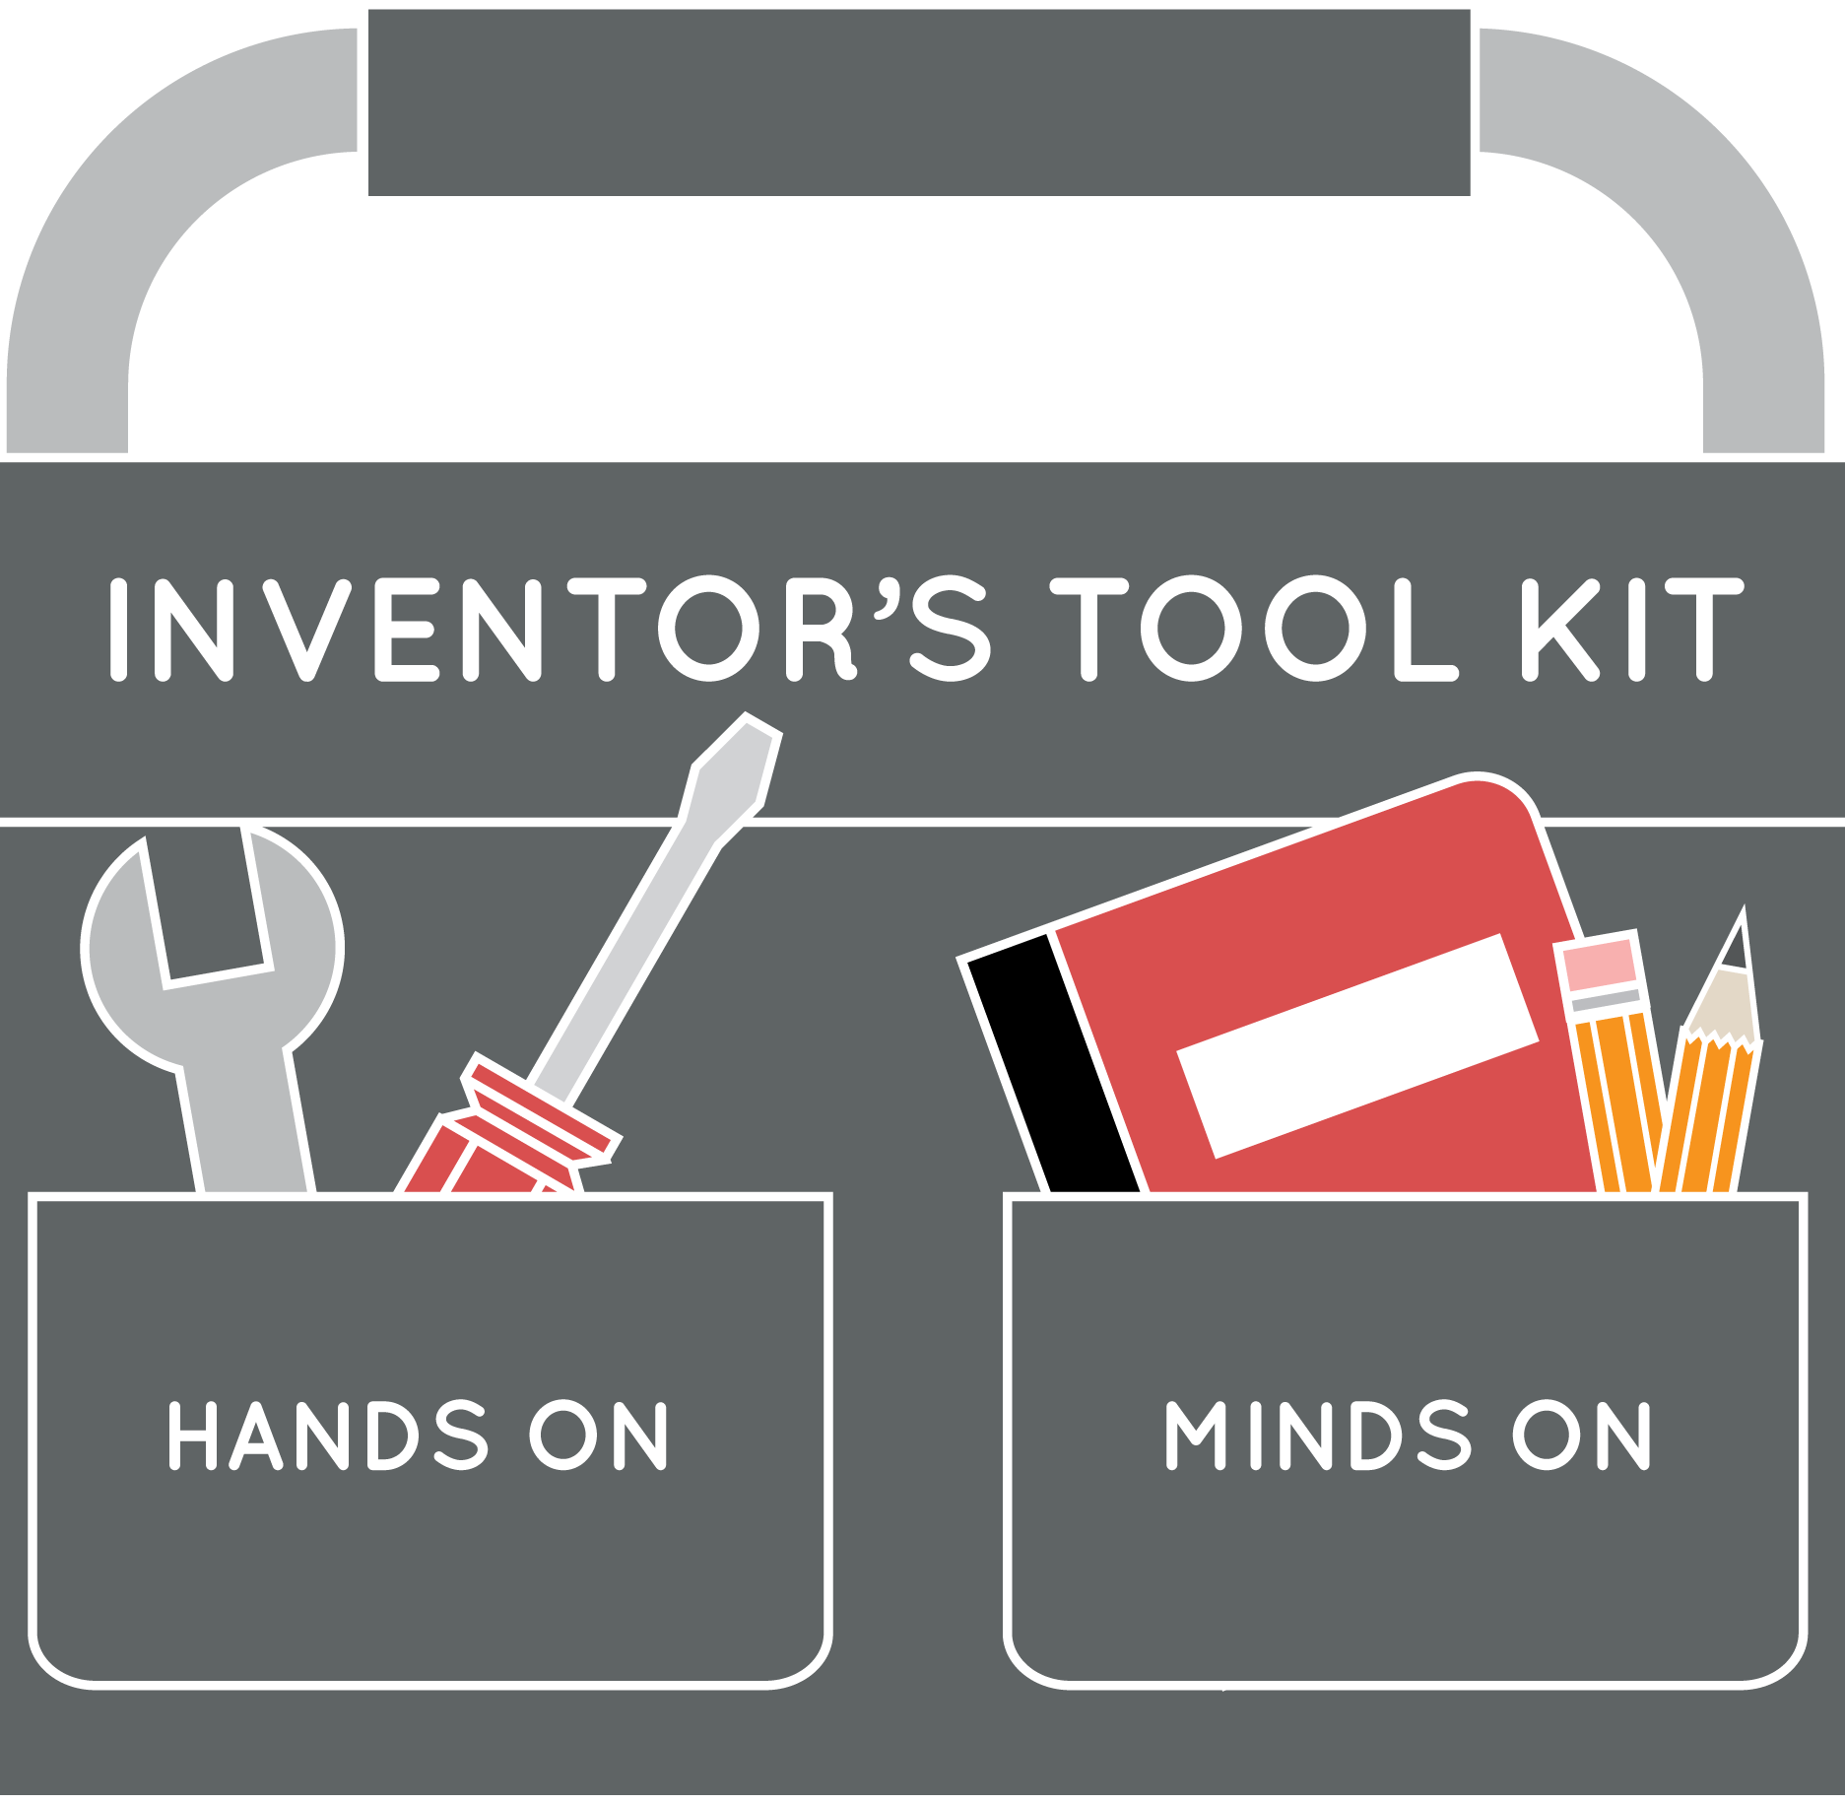
JV InvenTeams: Goals
Develop a foundation for open ended problem solving
Learn processes and how to use tools and materials
Cultivate curiosity and empathy through content/process
Prepare learners for STEM competitions like InvenTeams
Have fun!
Notes:
JV InvenTeams is all about FUN for both educators and students.
In addition to fun, there are also some important learning goals.
Students will develop a foundation for open ended problem solving. Students are pretty hard wired these days to finding the one right answer for an assigned problem. However, the great thing with invention is that there is no one right solution. Creativity and out-of-the box thinking drives the process. However, this new way of thinking can take some time for students to get used to.
Students will learn new processes and how to use tools and materials. Each activity unit introduces students to new sets of tools, materials, processes and skills.
Students will be asked to identify a problem in their community that could be solved using any combination of their new skills, materials, and tools at the end of each unit. They will learn empathy through the identification of needs.
Through their participation in JV InvenTeams, students will feel more confident and prepared to pursue future STEM competitions.

Slide 7
What is Invention?
An invention is a useful, unique contrivance that can be made or manufactured.
  Q: How does invention relate with the scientific method? Engineering design?
  A: Scientists ask questions; engineers define problems. Scientists construct explanations; engineers design solutions.
While you don’t have to be an engineer to be an inventor, many inventors are engineers.
Notes:
As you can see, JV InvenTeams is all about giving students a foundation in inventive thinking. But, what IS an invention?
If you look up the word “invention,” you are likely to come up with a variety of definitions. We like to use the one written here. Key words are useful and unique.
Useful: This is where the empathy comes in. The first step to find a good problem to solve is to talk to people about what they need to improve their lives. These people could become the beneficiaries or potential customers.
Unique: The solution should be novel and unique. Remember, the Lemelson-MIT Program was founded by a prolific American inventor with many patents for useful, unique contrivances.
A useful, unique contrivance - a physical object – should be able to be reduced to practice or made real. Models are built to prove the concept and then iteratively redesigned to build a working prototypes that can be evaluated by the beneficiaries or potential customers.
Inventions come from identifying problems AND appropriate solutions.
Remember, with invention, there is not one (right) answer. Some useful, unique solutions may be better than others. Students should be encouraged to discuss the various solutions and think about the impact of the solutions for the beneficiary AND for the environment.
Failure is OK. Encourage students to experiment, ask for feedback, and learn from what doesn’t work. Incorporate what’s learned into the next iterative solution.

Slide 8
Why Invent? Inventing…
Solves world problems like finding clean sources of energy
Helps people
Allows people to explore a creative process that often involves teamwork
Provides fulfilling careers. Inventors are often scientists and engineers who improve areas of health, energy, food and transportation
Can lead to a high paying career with many job opportunities in ever-expanding STEM fields
IS FUN!
Notes:
So why should students (and people of all ages) be inventing?
Read the words verbatim on screen
Altruistic desires of students – appealing to them!

Slide 9
How it Works
Grantees identify committed educator to lead meetings in afterschool
Grantees implement 2 activity units over the course of January – June 2017
Up to 20 students can participate
8 activity units to choose from
Grantees receive printed guides, tools/materials, and professional development
Field trip to college campus in spring
Notes:
Lemelson-MIT wants to make it as easy as possible to facilitate a JV InvenTeam.
Firstly, interested schools/sites must identify a committed educator to lead the program. He/she needs to recruit up to 20 students to participate. It’s important that the class is a mix of boys and girls.
This person will be in regular communications with LMIT staff. Grantees are expected to implement two units of activities from January through June. Grantees receive everything they need to implement the program. This includes printed guides, safety glasses/gloves, etc., materials, and tools. We work with a third party kitting company to ship materials.
Educators will be expected to attend a professional development training before the program begins.
All new teams begin with the Shoe Soles unit, our most popular and well-tested unit. Then, teams can select their second unit. I will provide a quick synopsis of each our 8 units in just a minute. From Jan – June you will meet weekly or bi-weekly to implement the units. They are each approximately 6-8 meetings in duration. Meetings typically take 1.5-2 hours to complete. You are welcome to split the meetings into sub-meetings to accommodate your needs.
Lemelson-MIT arranges a campus visit to university in the spring. Students will get to tour a school in Oregon and learn about the opportunities in STEM. LMIT reimburses for bus transportation and provides lunch.

Slide 10

JV Activity Units
Notes:
As I just mentioned, we now have 8 activity guides in our library! They are all available on the lemelson-mit website if you want to download and check them out. We also have some examples of guides here today for you to look through if you’d like.
Shoe Soles: All new teams start with Shoe Soles. In this unit students learn about biomechanics, shoe design, and the molding process. They build their own shoe sole prototypes. Then, teams can select their second unit.

Slide 11
JV Activity Units
Notes:
And here are some photos of students building and their prototypes from Shoe Soles.

Slide 12


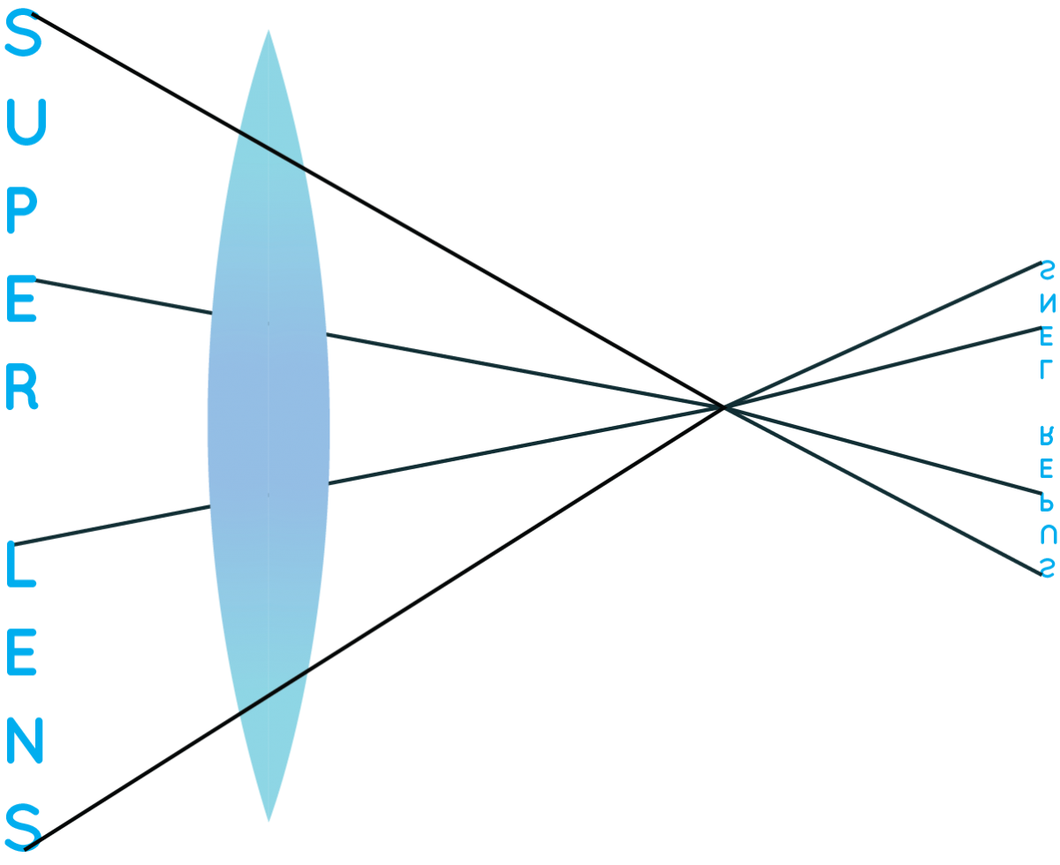




JV Activity Units
Notes:
Electronic Textiles: In this unit, students learn about basic circuitry. They make their own battery, create light-up designs on paper, and make wearable textiles that light-up.
Noise Makers: In the Noise Makers unit, students learn about sound waves and electromagnetism and build speakers and electric pickups for instruments.
Super Lens: In Super Lens, students learn about light rays and lenses, build a lens, and create a camera prototype.
Chill Out: In Chill Out, students learn about heat transfer, energy, and circuits. They build a lunchbox using pelteir tiles that keeps their food cool.
Growing Green: In Growing Green, students learn about hydroponic gardening, water management, and how to cut PVC pipe. They build a hydroponic gardening system.
Pump It Up!: In this unit, students learn about human energy and power, hydraulics, and pumps. They build their own water pump out of PVC pipe.
U Control: Finally, in U Control, students learn about mechanical systems, motor science, and circuits. They build a prototype of a door that opens automatically.

Slide 13
Paper Circuit Activity
This activity comes from Electronic Textiles unit
Make a light-up circuit on paper using:
  coin cell battery, conductive copper tape, circuit sticker
Notes:
Note to Bethany/Don/Tim: There are enough materials for folks to each make their own (sent 20 packets).
Explain that in the actual unit students will use surface mount LEDs (much smaller, a littler trickier to work with). Circuit stickers are unfortunately still too expensive to provide for all grantees.

Slide 14
Paper Circuit Activity
Tips:
  Copper tape has sharp edges. Be careful
  Circuits work best when the circuit sticker sits on-top of copper tape
Notes:
Don/Bethany/Tim – you can ask folks to share their light-up circuits. Explain that students can use another sheet of paper on-top of their circuit to design a light-up card or picture.

Slide 15
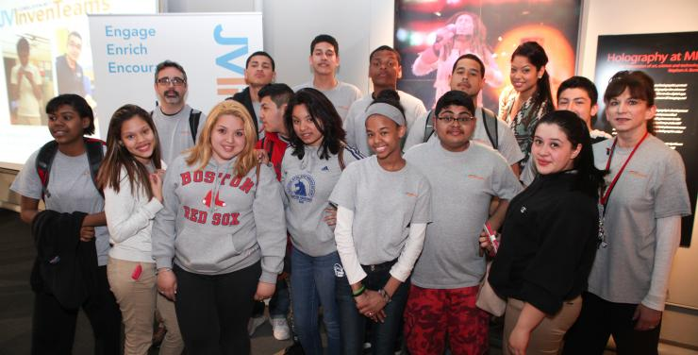
Deliverables
Upload 3 Forms on Team Access
  Program Liability
  Photo Release
  Survey Consent
Team photos on Team Access
Student blog entries on Team Access
Student and educator surveys
Regular communication
Notes:
So, we hope you are excited about all of the fun, hands-on JV content!
The Lemelson-MIT Program provides guidance, materials, tools, and activities. JV InvenTeam sites are expected to provide educators, space, students, and some deliverables via the Team Access portion of the JV InvenTeam website.
There are 3 forms that will need to be signed by students’ parents and uploaded to the website at the onset of the program. Also, we will ask educators to take a team photo in the JV InvenTeam t-shirts at the start of the program.
New this year we will have a blog portion of the Team Access site. Students will be expected to submit regular blog entries about their activities. These should be reviewed by educators before submission.
Your and the students’ feedback is valuable and will help Lemelson-MIT make needed changes for years to come! LMIT will ask students to complete short online surveys at the end of each activity unit. And LMIT will ask educators to complete an online survey at the end of the program in May or June.
The Lemelson-MIT Program expects regular communication with the key contact(s) at your site. There are different ways to communicate like through Team Access, email, and phone.

Slide 16
Feedback from Oregon City Service Learning Academy (OCSLA)
Notes:
Tim and Bethany are welcome to share some personal reflections/stories about OCSLA’s involvement with JV (students’ reactions, reception in community, testing activities at MIT, etc.).

Slide 17
Light Box Activity
This activity is adapted from the Super Lens unit
Follow the instructions on the hand-out to make your own light box viewer
If you do it correctly, you should see an inverted image on the vellum

Slide 18
How to Apply
21st CCLC coordinators should apply
Educator does not need to be identified yet to complete an application
Online application via Slideroom
Link is here: https://lemelsonmit.slideroom.com/#/permalink/program/32817/Oh3Wvth1EK
Deadline is December 1st
Contact Liza at Lemelson-MIT with questions
Notes:
We hope you excited about the possibilities of becoming a JV InvenTeam this year. Lemelson-MIT has a limited number of slots still open so we encourage you to apply at your earliest convenience. The deadline is coming up quickly on Dec. 1.
The link is here but Liza can also email it out.

Slide 19
Questions
Notes:
We are happy to answer any of your questions now.

Slide 20
Inventing is Plain Fun!
Contact Liza: lizag@mit.edu or 617-452-2145
Visit the website for more info: http://lemelson.mit.edu
Notes:
We want to thank you for taking the time to participate in this workshop today. Please reach out to Liza with any questions!

