Slide 1
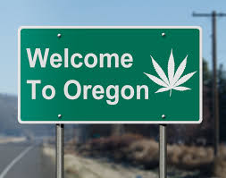
Drug Impairment Training
Sergeant Greg Plummer
Oregon State Police- Tillamook

Slide 2
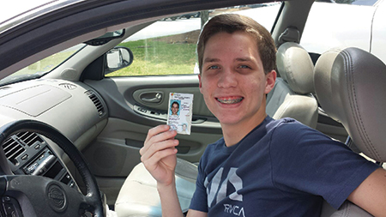
Should we worry about him?

Slide 3
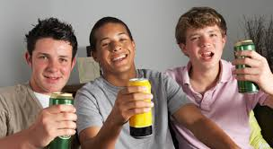
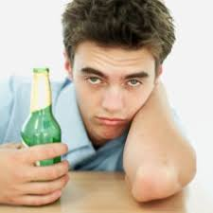
How about these guys?

Slide 4
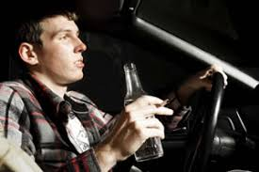
Worried now?..... I am!

Slide 5
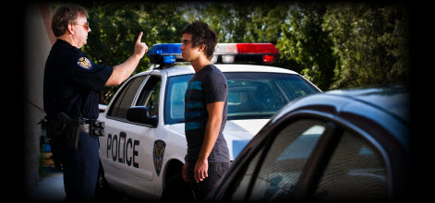
Unfortunately this happens too often

Slide 6
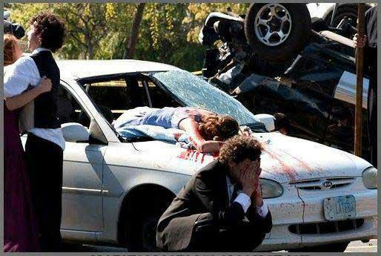
So does this

Slide 7
The Oregon DUII Problem
In 2015, 445 people were killed in fatal traffic crashes on Oregon roads.
155 of those traffic crashes (35%) involved at least one alcohol impaired driver.
The total for 2016 is 495 fatalities- up 58% from 2013 statistics (313)
154 of those fatal crashes (31%) involved at least one alcohol impaired driver.

Slide 8
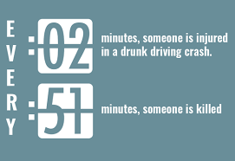
MADD Statistics

Slide 9
What about drug use?
Driving under the influence of drugs is on the rise in the United States. This is starting to be tracked like alcohol in local and national crash statistic databases.

Slide 10
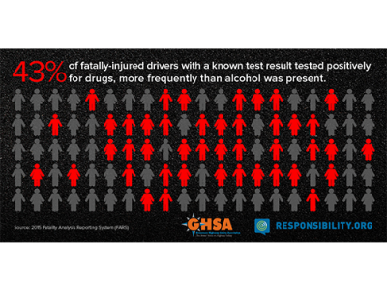
Some fatal crash drug impairment statistics

Slide 11
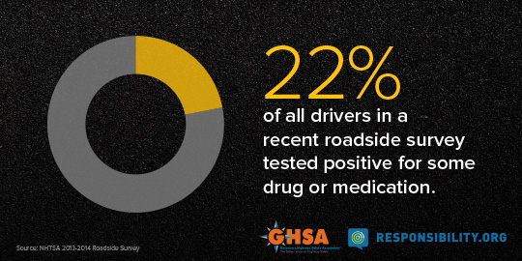

Slide 14
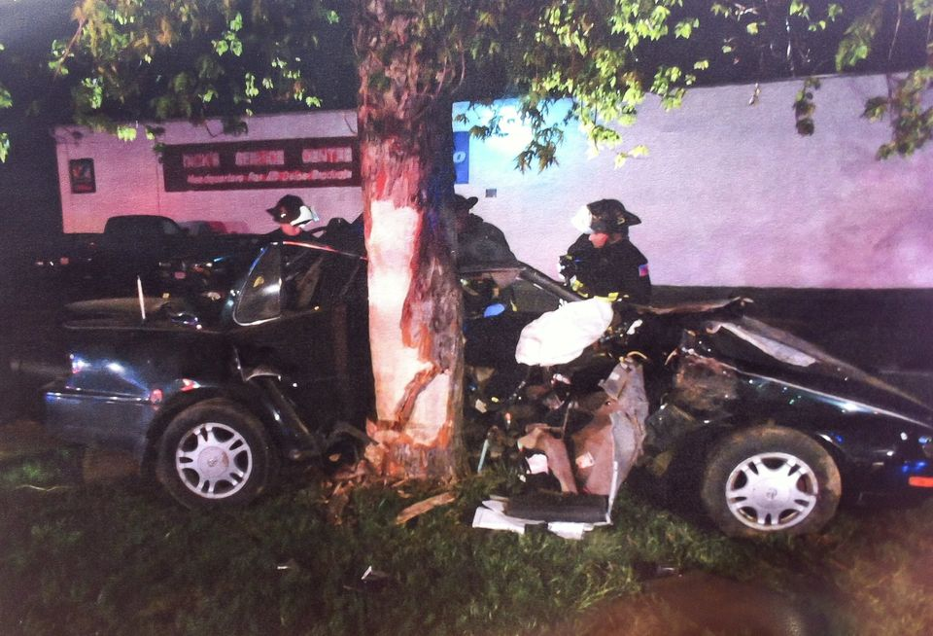
Ultimate Goal
Increase DUII deterrence and decrease crashes, deaths, and injuries related to impaired driving.

Slide 15
Definition of Drug
For Law Enforcement Purposes a drug is:
Any substance, which when taken into the
human body, can impair the ability of the
person to operate a vehicle safely

Slide 16
DUII Investigation
A Law Enforcement DUII Investigation Consists
of Three Phases:
1- Vehicle in Motion
2- Personal Contact
3- Pre-Arrest Screening
Impairment is often observed in all three phases

Slide 17
DUII Investigation
Arrests are made based on “the totality of the circumstances”…
The burden of proof in court proceedings is that the person’s mental and/or physical faculties were impaired to a noticeable or perceptible degree.

Slide 18
Impairing Substance Categories
CNS- Depressants
CNS- Stimulants
Hallucinogens
Dissociative Anesthetics
Narcotic Analgesics
Inhalants
Cannabis

Slide 19
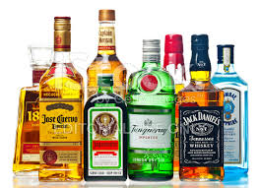
CNS- Depressants
Far and away the most common one we all encounter is still alcohol.

Slide 20
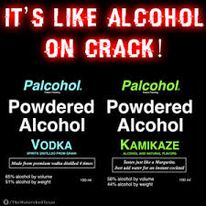
Powdered Alcohol

Slide 21
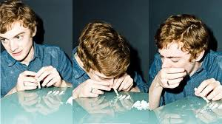
Could be used this way

Slide 22
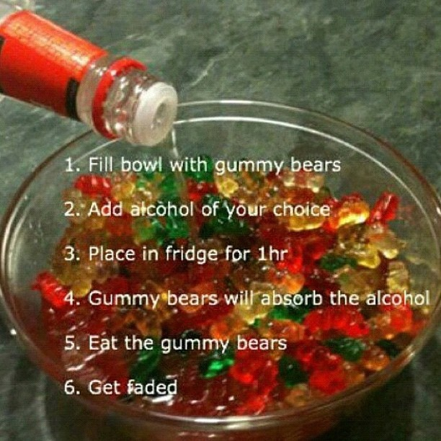
Alcohol soaked gummy bears

Slide 23
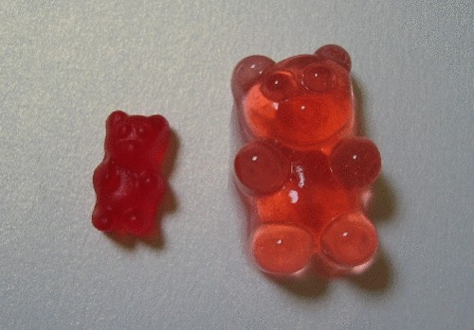
The gummy bears increase in size

Slide 24
Alcohol enema?…

Slide 25
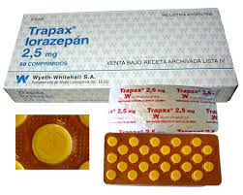
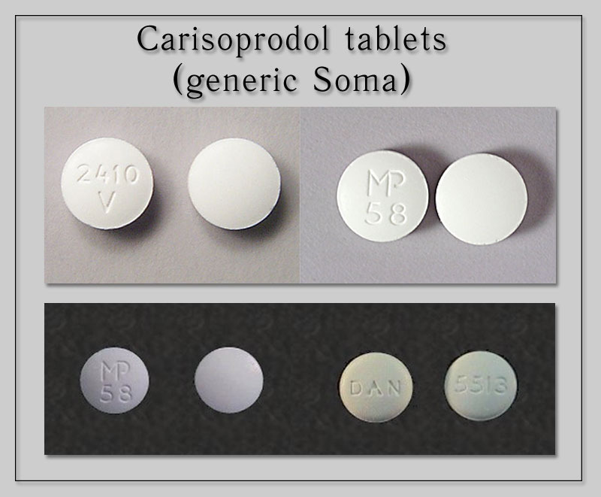
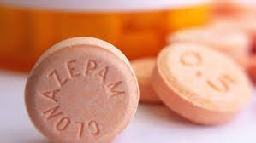
Other common CNS Depressants

Slide 26
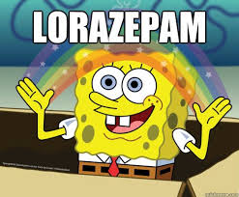

Slide 27
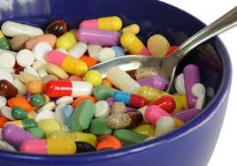
There are all types of medications available to young drivers in virtually every household

Slide 28
Summary of CNS Depressants
Impairment from drugs in this category will be similar to what is observed with alcohol, without the odor of alcohol
Look for slurred speech, bloodshot eyes, droopy eyelids, dazed appearance, balance problems, difficulty with divided attention tasks…. drunk-like behavior

Slide 29
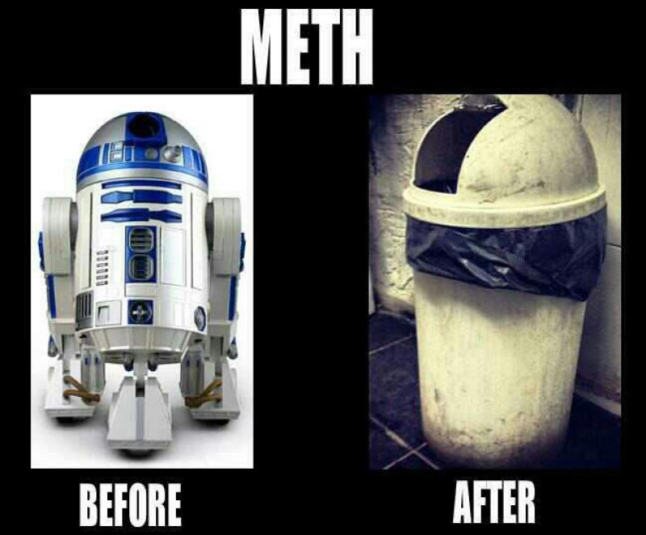
CNS- Stimulants

Slide 30
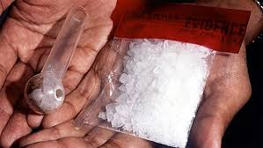
Methamphetamine

Slide 31
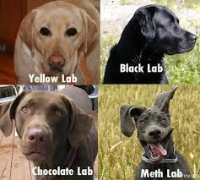
How to spot a stimulant impaired dog…

Slide 32
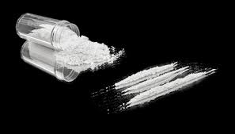
Cocaine

Slide 33
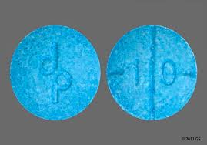
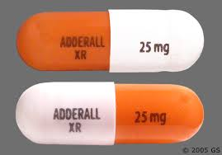
Adderall

Slide 34
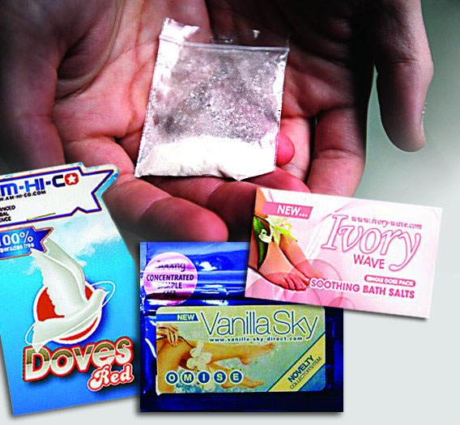
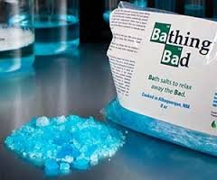
Bath Salts

Slide 35
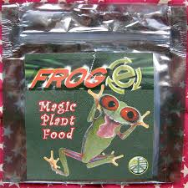
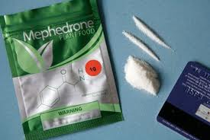
Plant Food

Slide 36
Summary of CNS- Stimulants
Signs of impairment include dilated pupils, rapid speech and movements, anxiety, agitation, increased alertness, fidgety (sometimes to the point where some part of the body is always moving), grinding teeth, rigid muscle tone.

Slide 37
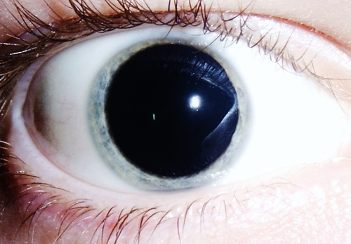
What do we mean by dilated pupils?

Slide 38
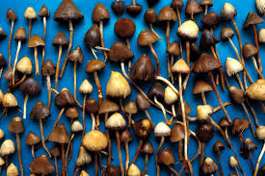
Hallucinogens
Psilocybin mushrooms, LSD, Peyote, Bufotenine

Slide 39
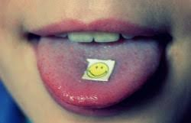
Blotter paper acid (LSD)

Slide 40
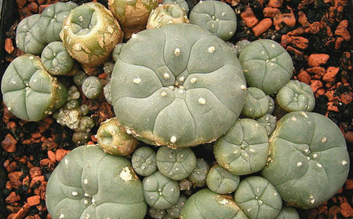
Peyote

Slide 41
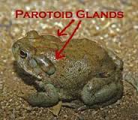
Bufotenine Toad

Slide 42
Summary of Hallucinogens
Signs of impairment include very dilated pupils, perspiring, dazed appearance, hallucinations, synesthesia (transposition of senses); increased pulse, blood pressure and body temperature, paranoia

Slide 43
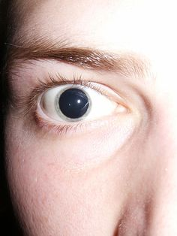
Again, very dilated pupils!

Slide 44
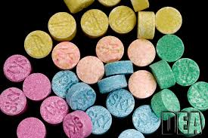
Ecstacy- a psychedelic amphetamine
Users will often have signs of impairment from both CNS- Stimulants and Hallucinogens

Slide 45
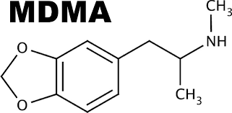
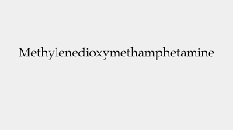
MDMA = Ecstacy

Slide 46
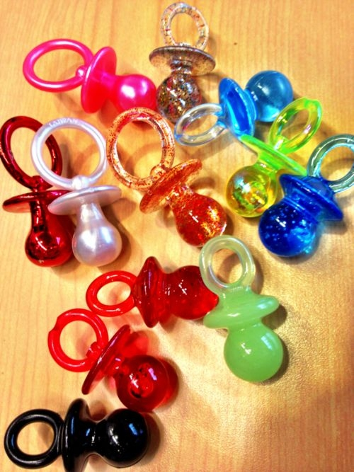
Things commonly associated with ecstacy

Slide 47
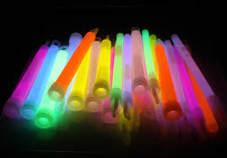
Rave paraphernalia

Slide 48
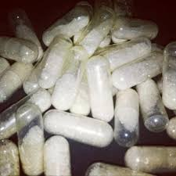
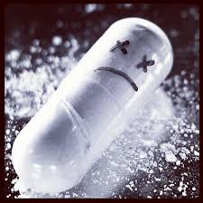
“Molly”

Slide 49
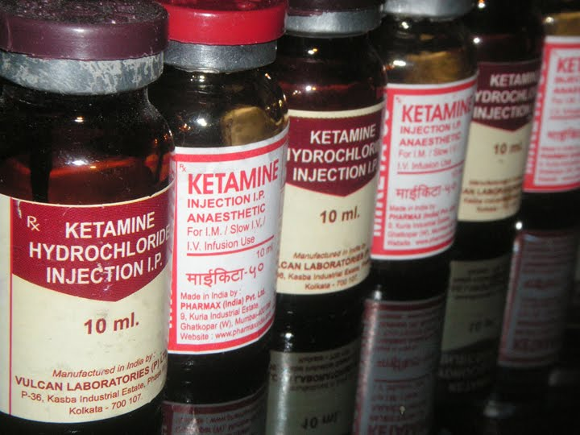
Dissociative Anesthetics

Slide 50
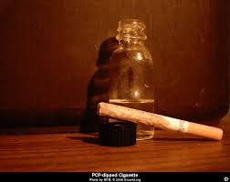
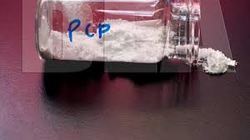
PCP

Slide 51
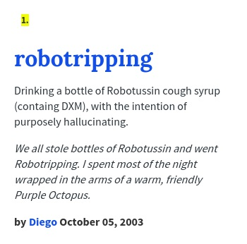
Robotripping

Slide 52
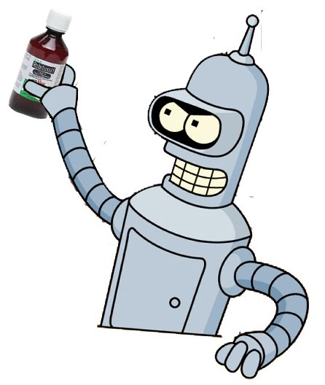

Slide 53
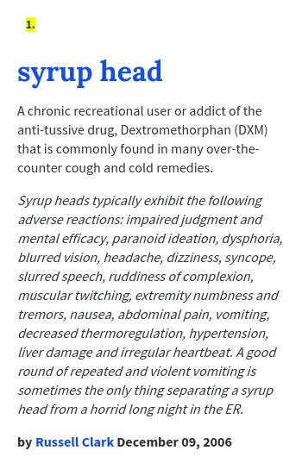
Syrupheads

Slide 54
Summary of Dissociative Anesthetics
Signs of impairment include dazed appearance, delayed/incomplete responses, cyclical behavior, repetitive speech, high body temperature (would most likely be at least partially naked), high pain tolerance…..

Slide 55
High pain tolerance
People using dissociative anesthetics often can’t feel pain while under the influence of drugs in this category.

Slide 56
Narcotic Analgesics

Slide 57
Heroin- Chasing the Dragon

Slide 58
Heroin

Slide 59
Fentanyl

Slide 60
Krokodil= Desomorphine

Slide 61
Other Narcotic Analgesics

Slide 62
Codeine

Slide 63
Summary of Narcotic Analgesics
Signs of impairment include constricted pupils, droopy eyelids, on the nod, relaxed appearance, flaccid muscle tone, slow speech, delayed responses.

Slide 64
Naloxone

Slide 65
Narcotic Analgesic constricted pupils

Slide 66
How normally functioning pupils work
The pupils naturally open and close based on lighting conditions. In bright sunlight, the pupils constrict to limit the amount of light let into the eye. In darkness, the pupils open wide to gather as much light as possible.

Slide 67
Drugs that affect pupil size also impact a person’s ability to drive safely!
A person taking a drug that dilates pupils will have difficulty seeing in bright sunlight… or with oncoming headlights at night.
A person taking a drug that constricts pupil size will have difficulty seeing, particularly at night because their pupils will not open wide to gather light.

Slide 68
Another drug induced vision problem affecting the ability to drive safely
Horizontal Haze Nystagmus-
This is an involuntary jerking of the eyes as they track an object moving horizontally….

Slide 69
Horizontal Gaze Nystagmus
As the eyes track the horizontally moving object, they lag behind and are constantly trying to catch up due to impairment of the muscles controlling eye movement, causing them to “skip” toward the object. With each skip, vision and tracking is affected.

Slide 70
Horizontal Gaze Nystagmus Test

Slide 71
Horizontal Gaze Nystagmus
The drug categories that produce HGN include:
-CNS-Depressants (including alcohol)
-Inhalants
-Dissociative Anesthetics
VGN also occurs indicating a high dose of the impairing substance for that individual

Slide 72
INHALANTS

Slide 73
Inhalants are primarily common household substances that are easy to obtain…

Slide 75
Hardcore huffers often look like this!

Slide 76
Abuse of other Aerosols

Slide 77
Dust off abuse is very common

Slide 78
Nitrous Oxide from Whip Cream Cannisters

Slide 80
Health Concerns - Inhalants

Slide 81
Some additional inhalants sold at “head shops”

Slide 82
Summary of Inhalant Impairment
Confused, disoriented, unresponsive, slurred speech, incomplete verbal responses, droopy eyelids, dazed appearance, uncoordinated. May appear to be extreme alcohol intoxication. May have a distinct odor of the impairing substance.
Signs of impairment may dissipate very rapidly, and the person’s condition may improve as you are talking to them.

Slide 83
CANNABIS

Slide 84
Legalise Cannabis?

Slide 85
Comparison of First Week of Legal Sales

Slide 86
Cannabis Dispensaries

Slide 88
Cannabis Dispensary Labels

Slide 89
Another Label

Slide 91
Dispensary “Exit Bag”

Slide 95
THC vs. CBD

Slide 96
Common smoking paraphernalia

Slide 97
This is paraphernalia…

Slide 98
It’s a dabber for doing this…

Slide 99
Dabs are very popular right now

Slide 100
Shatter, Wax and Sugar
These are all marijuana products that are refined to the point where they have extremely high THC content

Slide 101
Butane Honey Oil (BHO)
AKA- Butane Hash Oil

Slide 102
BHO lab explosion

Slide 103
Another BHO Explosion

Slide 104
Rick Simpson Oil (RSO)

Slide 105
Cannabis Tinctures

Slide 106
Vaping is very common

Slide 107
An oil vape pen setup

Slide 108
Marijuana edibles
Candy and brownies…

Slide 110
Cookies

Slide 111
All Cannabis Cookies

Slide 112
Cannabis Candy vs. Regular Candy

Slide 114
Sour gummies

Slide 115
Beverages

Slide 116
Pot Shots and Cannabis Sodas

Slide 117
Other Cannabis Products

Slide 118
Summary of Cannabis Impairment
Subjects under the influence of Cannabis often have dilated pupils (though not always). They will often have bloodshot eyes, redness around the eyes, an impaired perception of time and distance, paranoia, cognitive impairment often related to short term memory, raised taste buds, green coating on tongue, marijuana debris in mouth, odor of marijuana on their person.

Slide 120
Redness around the eyes

Slide 122
Federal Aviation Administration Study
Pilots given doses of Marijuana and pacebos
Performed poorly in flight simulator
24 hours later, did not feel high, but 50% still had divided attention problems
48 hours later, 25% of the test group still showed the same problems.

Slide 123
Scooby Snacks?

Slide 124
These “scooby snax” will get you high…
…it’s synthetic cannabis

Slide 125
Other synthetic cannabinoids

Slide 126
Some drug paraphernalia to be looking for…
Stash containers

Slide 127
More stash containers
These are just a few. There are many, many more….

Slide 128
“420”
“420” is a culture. There are a lot of theories as to how 420 came to be slang for using MJ

Slide 129
The 420 culture is spreading to other areas

Slide 130
420
Some people smoke marijuana every time the clock hits 4:20, and all day on April 20th each year. This is coming soon!

Slide 131
710
710 is another popular drug reference number related to Cannabis…

Slide 132
710 = OIL
BHO users often wear 710 labeled clothing or have 710 bumper stickers

Slide 133
Cannabis Cures Cancer campaign

Slide 134
What type of laws are on the books related to Cannabis
There are traffic laws similar to those related to alcohol and juvenile laws similar to MIP…
So no open containers inside vehicles, even for passengers…..
…and illegal for juveniles in all circumstances unless they are OMMP participants and have a prescription.

Slide 135
Can you get a DUII while under the influence of marijuana?
It is STILL not legal to drive under the influence of marijuana or other impairing substances…..
It doesn’t matter if it is a prescription medication, even taken as prescribed…
DUII is DUII regardless of whether the substance is legal to possess

Slide 136
Kratom

Slide 137
Kratom
KratomThe leaves of kratom have been used as an herbal drug from time immemorial by peoples of Southeast Asia. It is used in folk medicine as a stimulant (at low doses), sedative (at high doses), recreational drug, pain killer, medicine for diarrhea, and treatment for opiate addiction.

Slide 138
Salvia Divinorum

Slide 139
Food for Thought
-Oregon is one of the last remaining states that do not have laws on the books making it illegal to drive under the influence of ANY impairing substance.
-In Oregon, the substance must be DEA Schedule I-IV, alcohol, or an inhalant, in order for the person to be convicted of DUII.
-Impairing substances like diphenhydramine (Benadryl/Sominex), dextromethorphan (Robitussin/Coricidin), salvia, or non-scheduled prescription controlled medications will not result in a conviction for DUII.

Slide 140
DUII vs Reckless Driving
Even though a person cannot be convicted for DUII when under the influence of certain substances, they can still be convicted of Reckless Driving
It is considered reckless to drive after consuming an impairing substance.
If the reason for the stop doesn’t involve bad driving a Reckless Driving conviction may not be obtained either

Slide 141
A good reference website
Officially called the Vaults of Erowid, located at erowid.org…..

Slide 142
RXList- Drug Information and Pill Identifier

Slide 143
Poison Control Center

Slide 144
Additionally…..
Contact pharmacists for drug information to include first aid information
Emergency Room physicians and nurses are excellent resources
Dial 911 for medical or law enforcement help if the situation has become an emergency

Slide 146
DUII Crashes are 100% Preventable
Together we can make a difference and reduce those DUII fatal and serious injury crash numbers!
I hope you have learned some useful information through this presentation.

Slide 147
Questions?

Slide 148
Contact Information
Sergeant Greg Plummer
Oregon State Police- Tillamook Worksite
greg.plummer@state.or.us
(503)815-3372

