Slide 1
Title X Training
Assisting Homeless and Highly Mobile Students
in Oregon School Districts

Slide 2
Essential Legislation
McKinney-Vento
Homeless Assistance Act
Education of Homeless Children & Youth
a.k.a.
ESEA - Title X
Notes:
The McKinney-Vento Homeless Assistance Act is an omnibus piece of 1987 legislation, implemented in multiple federal agencies including Housing and Urban Development (HUD), Health & Human Services (HHS), Labor, USDA, Education, etc. MVA Subtitle VII-B, the Education of Homeless Children and Youth program (EHCY), was adopted under the ESEA as Title X in 2002.

Slide 3
Essential Definition
-- HOMELESS --
Lack of a
fixed, regular and adequate
nighttime residence
Notes:
Fixed residence: not temporary -- stationary, permanent, not subject to change
Regular residence: used on a regular (e.g., nightly) basis
Adequate residence: sufficient to meet both physical and psychological needs typically met in home environments

Slide 4
K-12 Homeless Students in Oregon
Notes:
State total counts of K-12 homeless students have increased steadily. The dip in years 2012-13 and 2013-14 aligns with a major change in the method of data input at districts. During the recession from 2010-2012 , counts reach highs of around 20,000 students. The 2014-15 count, to be released in the fall, shows a total in the range of 22,500 students, with thousands more homeless children counted in preschool grades and younger.

Slide 5
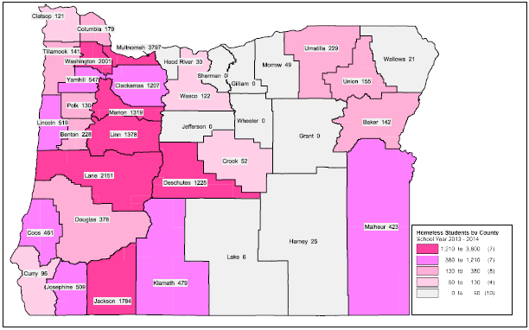
Notes:
Distribution of homeless students in Oregon Counties

Slide 6
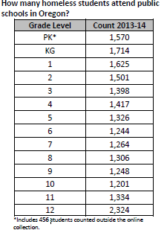
2013-14 School Year Homeless Students by Grade
Notes:
Homeless student numbers are greater in early grades and also Grade 12.

Slide 7
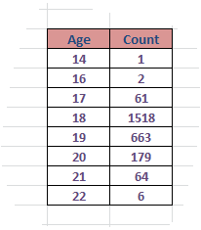
Ages of Homeless Students in Grade 12
Notes:
Grade 12 homeless students may have been held back a grade or are 5th year seniors.

Slide 8
Eligible Living Situations
Shelter or Transitional Housing
Unsheltered
Motel or Hotel
Doubled-up / Sharing Housing
Notes:
Four “homeless” living situations recognized by the McKinney-Vento Education Program.

Slide 9
Oregon’s Homeless Student Living Situations
Notes:
Most of Oregon’s homeless students are in Doubled-Up living situations – like other states.

Slide 10
Shelters and Transitional Housing

Slide 11
Unsheltered
Sleeping in a vehicle: car, trailer
Public spaces, parks, bus stations
Abandoned buildings, garages, sheds
Substandard housing features (e.g.):
lacking utilities
unsafe, unfit for children
overcrowded housing
Notes:
US Census: Overcrowded housing is >1.5 people per livable room

Slide 12
Motel or Hotel
due to lack of alternatives, for reasons such as:
Cannot find rental housing due to lack of deposit money, rental history problems, felony record, etc.
No other housing available
On a public housing voucher (counts as Shelter)

Slide 13
Doubled-Up / Sharing Housing
Staying with friends or relatives due to:
-loss of housing
-economic hardship
-other similar reason
May be terminated without notice
Determined on a case-by-case basis
Liaisons need to weigh circumstances of long-term situations to determine “permanency”

Slide 14
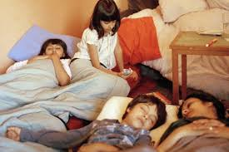
Doubled-Up and Overcrowded

Slide 15
Unaccompanied Students
Not supervised by a parent or guardian
Includes runaway, abandoned and “couch-surfing” youths
Have the same MV rights as children in homeless families
Can enroll themselves, without permission
Liaison may need to be emergency contact

Slide 16
Unaccompanied Homeless Children & Youth
Notes:
Unaccompanied homeless children are not all runaways. Some younger children become unaccompanied when parents are incarcerated or deported, and children are left with friends or neighbors.

Slide 17
Preschool and Younger
All districts must include public preschools and local Head Start programs in homeless data collection
May need to work with Head Start programs to see they provide children with SSIDs before count
Liaisons should connect with Early Learning Hubs (see next slide) for additional support

Slide 18
Early Learning Hubs by Region

Slide 19
Responsibilities of Districts
Designate an ACTIVE District Liaison
Post notices on rights of homeless students with Liaison contact information
Provide transportation to school-of-origin
Revise policies that create barriers
Notes:
Maintaining compliance with Title X involves ongoing attention by district administrators. ODE maintains state compliance with Title X by providing technical assistance to districts and to homeless parents and youths, conducting district risk assessments, monitoring and collaboration with state and local service providers.

Slide 20
District Liaison Duties
Identify homeless students and younger siblings
Ensure access and enrollment in public schools
Facilitate student access to education and services, such as: counseling, preschool, Head Start, early intervention, school meals, health services, housing referrals, FAFSA
Arrange Transportation if needed, for K-12 homeless students. Preschool transportation is optional but encouraged.
Report Submit count data to ODE (June 2016)

Slide 21
Homeless Student Needs
School supplies, backpacks, hygiene products, clothing , shoes, coats and other essentials needed to attend school
Tutoring, credit recovery, other education services such as alternative ed., GED
Help families and youth obtain immunizations, health services, birth certificates, etc.
Notes:
Liaisons usually have standard school and hygiene supplies handy at their office.
Backpacks and grade-level appropriate supplies are often needed.
Some Liaisons organize donations of goods and supplies.
Birth Certificate replacement fees can be covered with Title I-A funds (around $30).
Liaisons should refer families without health insurance to the Oregon Health Plan (OHP)

Slide 22
Preschool-Age Children
Head Start programs try to prioritize enrollment of homeless children
Counts of homeless Head Start children are included in district of residence.
Refer homeless families with toddlers for screening and assessment for Early Intervention/Early Childhood Education
Notes:
Compulsory School Attendance not required until age 6, however parents of homeless and low income children are urged to enroll their children in preschool or Head Start as early as age 3.
Early Intervention screening is suggested for all young children in homeless families.
Regional ESDs have EI/ECE programs.

Slide 23
Professional Development
National Center for Homeless Education- NCHE http://www.serve.org/nche/
Monthly webinar trainings for Liaisons, also topic briefs, toolkits, posters, etc.
Safe Schools - online all-staff training
http://www.safeschools.com/courses/index.php
Homeless Students: Awareness Understanding
Human Trafficking Awareness
Notes:
- All Liaisons should review information on NCHE website and participate in at least one webinar.
- NCHE Briefs include MV Act provisions in margins.
Abridged MVA available from State Coordinator to help respond to questions.
Many districts have all personnel take SafeSchools online training on Homeless Students – however, this training alone is insufficient for designated Liaisons (NCHE webinars and ODE trainings recommended).

Slide 24
Uses of Title I-A Set-Asides
Funds may be used for services not ordinarily provided to other Title I students, such as:
Student participation fees
School clothing and shoes, including
PE clothes and athletic shoes
Class materials and field trip fees
School supplies including backpacks
Birth Certificate replacement fee
Food & Water
Urgent medical and dental services
Notes:
Districts should first address needs of homeless students in non-Title I funded schools before using funds for other Title X purposes.
Examples of items not covered: Computers, clothing for parents, class rings, yearbooks.
See ODE Homeless Education webpage for more information.

Slide 25
Oregon Title X Program
ODE Homeless Education Website
http://www.ode.state.or.us/go/HomelessEd
Oregon Liaison Listserv
Email Dona.Bolt@state.or.us to join

Slide 26
At Your Service!
Dona Bolt, State Coordinator
Homeless Education
(503) 947-5781
dona.bolt@state.or.us

Slide 27
Thanks for All You Do!!

