Slide 1
Community-Supported STEAM Innovations
Beyond School Hours XXI
National Education Conference
Orlando, Florida
February 2018

Slide 2
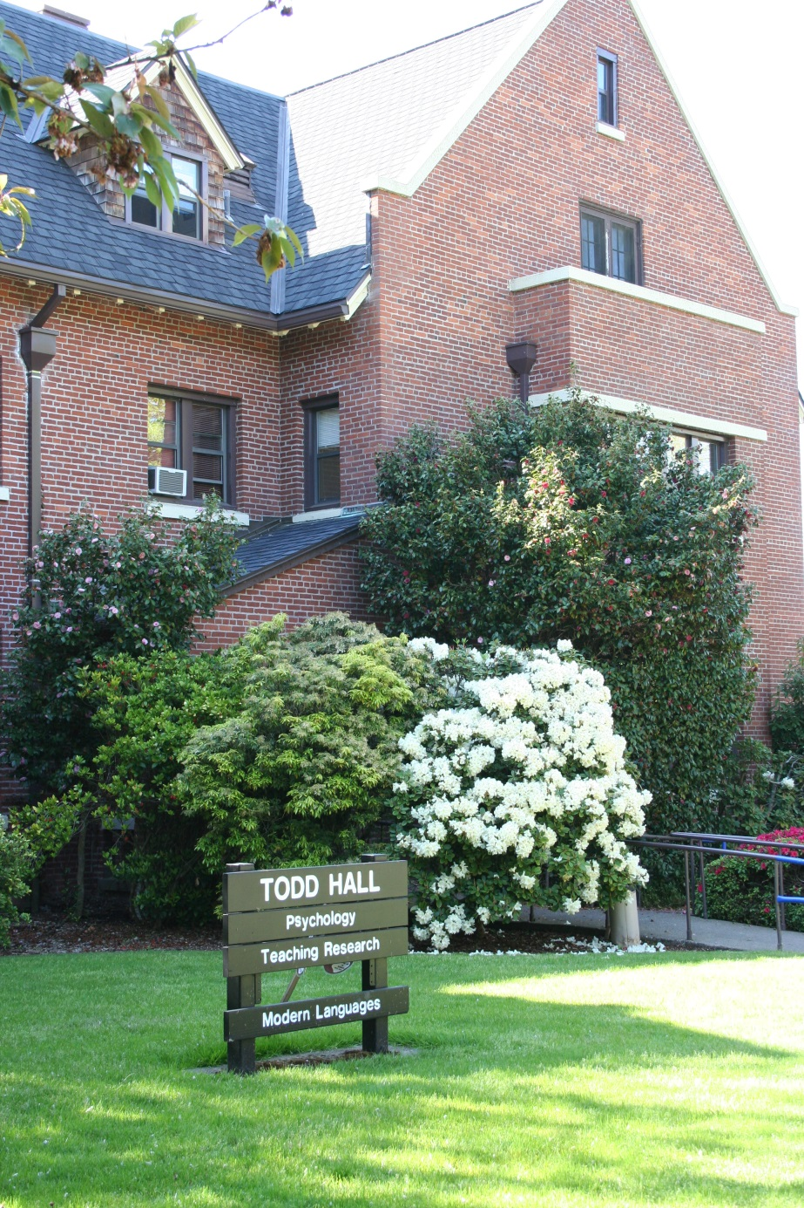
WELCOME!
Candi Scott, Gary Glasenapp,
Roxanna Marvin, and Cori Brownell
The Research Institute at
Western Oregon University
http://triwou.org/projects/cclc
Notes:
Who we are and our role with Oregon’s 21st CCLC programs. Ask audience which types of programs they work in: 21st CCLCs, other afterschool programs (YMCA, Boys & Girls Clubs, etc.) Ask what their roles are: instructors, site coordinators/managers, Program Directors, etc.

Slide 3
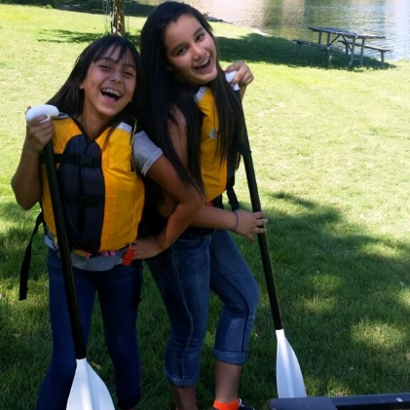
Agenda
Materials/Workshop Outcome
Reflective Activity & Group Sharing
Review Your “Why”
Types of Community Support
Oregon’s 21st CCLC Community-Supported STEAM Innovations
Final Reflections

Slide 4
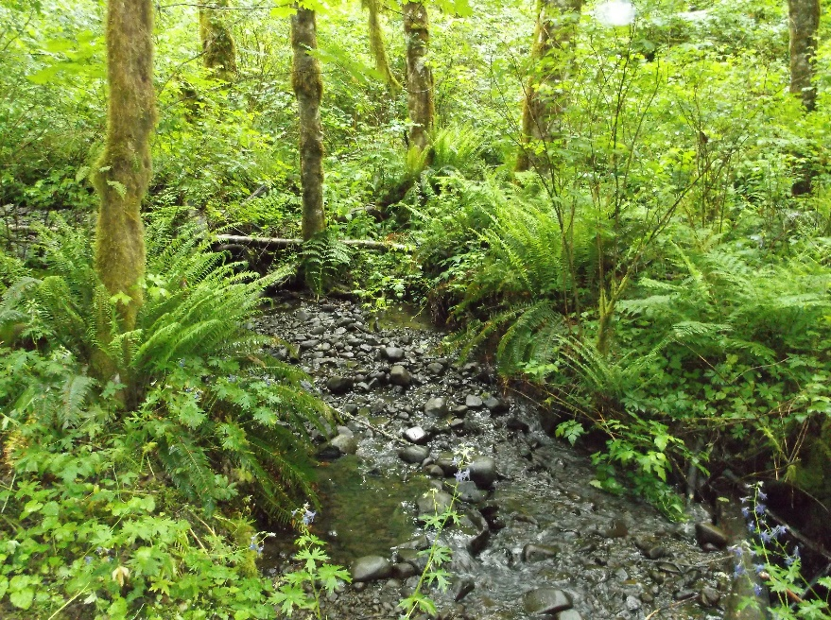
Workshop Outcome
Participants will learn new ideas about how to utilize community resources for project-based STEAM innovations in
out of school time programs.

Slide 5
Reflective Activity
What community resources are you already using in your out of school time programs to support project-based STEAM learning?

Slide 6
Famous Trios Sharing and Group Recording
Share your reflections in your groups of three
Add your ideas on the paper provided
Share with the whole group

Slide 7
Why Utilize Partnerships and Resources?
Oregon’s 21st CCLC programs do this to:
Save money to SUPPORT PROGRAM SUSTAINABILITY!
Expand programming options
Incorporate youth voice in activities
Build partnerships with the community
Model to students how to advocate for needs
Why else?

Slide 8
Types of Community Support: Sorting Activity
In your table groups sort your cards into the following categories of community supports:
Expertise
Personnel
Resources
Funding

Slide 9
Community-Supported STEAM Innovations Klamath Falls
Fish dissection and printing (US Forest Service).
Outdoor hiking, nature flora and fauna exploration (Moore Park, Great Outdoors Alliance, and Klamath Watershed Partnership).

Slide 10
Community-Supported STEAM Innovations Klamath Falls
Dental Education (Oregon Institute of Technology dental hygiene students)

Slide 11
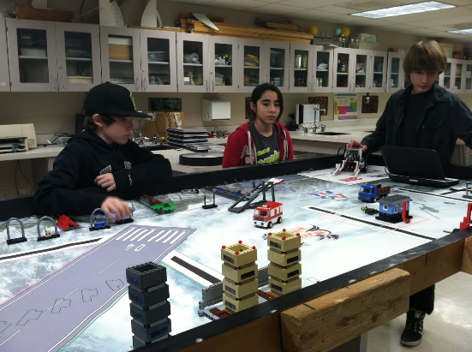
Community-Supported STEAM Innovations Umatilla
Tiny House
Construction, FIRST (Robotics), and Hover Lab

Slide 12
Community-Supported STEAM Innovations Klamath Falls
BMX Racer Project

Slide 13
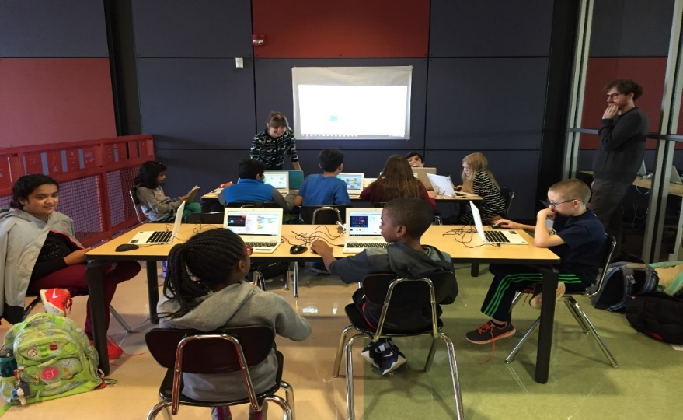
Community-Supported STEAM Innovations Impact NW (Beaverton)
AKA Science
Coding Club

Slide 14
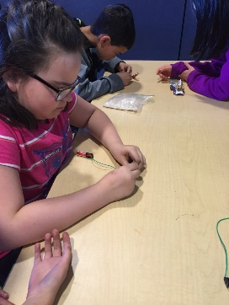
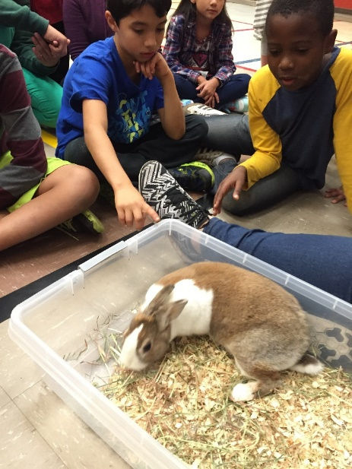
Community-Supported STEAM Innovations Impact NW (Beaverton)
Physics
Hands On Math Club
Zoo Animal Visit

Slide 15
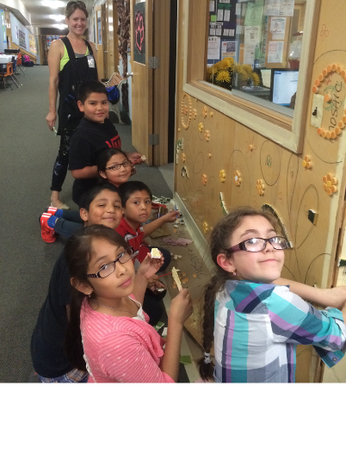
Community-Supported STEAM Innovations Hood River
Columbia Gorge
Arts in Education Partnership

Slide 16
Community-Supported STEAM Innovations Hood River
FUSE Grant

Slide 17
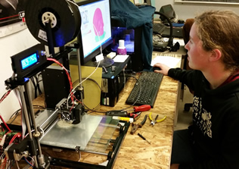
Community-Supported STEAM Innovations Three Rivers
3D Printing

Slide 18
Community-Supported STEAM Innovations Eugene
STEM in the Garden (the School Garden Project).
Partnerships also include
Eugene Springfield Youth Orchestra,
Eugene Symphony,
PAAWS (People And Animals Who Serve), and
the Eugene Rotary Club.

Slide 19
Community-Supported STEAM Innovations Lincoln County
Making butter with OSU Extension STEAM mentor

Slide 20
Community-Supported STEAM Innovations Lincoln County
Students work with local artist to complete a mural in the school cafeteria. Programming has also included creating their own drones from recycled materials.

Slide 21
Community-Supported STEAM Innovations Portland
Partnerships include:
AKA Science,
Ethos,
Concordia University,
Northwest Children’s Theater. Programming includes:
Garden Club,
Kitchen Chemistry,
Lego Robotics,
Bucket Drumming, Dance, and Music.

Slide 22
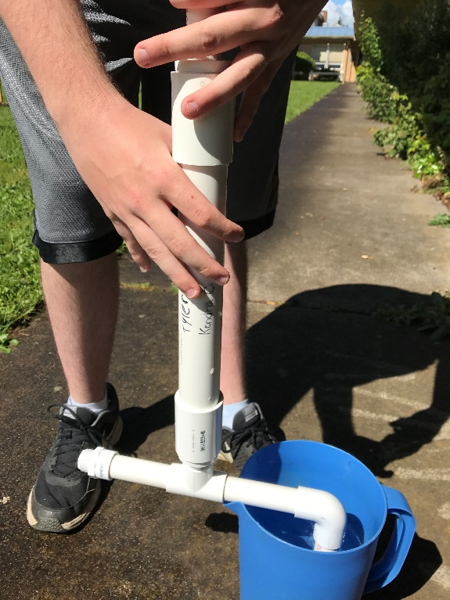
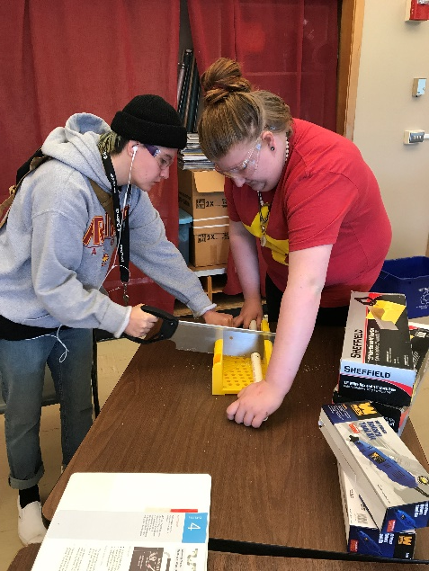
Community-Supported STEAM Innovations Oregon City
JV InvenTeams creating a hydroponic gardening system

Slide 23
Professional Action Reflection
What I will stop doing
What I will continue doing
What I will start doing

Slide 24
Closing Activities
Questions?
Workshop Evaluations
THANK YOU!

