Slide 1
Culturally Responsive Screening and Assessment
Teaching Research Institute
Western Oregon University
Click to begin

Slide 2
This project made possible by…
A grant from the US Department of Education
Office of Special Education Programs
Notes:
Patti: Welcome. This project is made possible by a grant for the US Department of Education under the Office of Special Education Programs. The main focus of the grant was to provide community colleges with ideas and enhancements to redesign their curriculum incorporating evidence based practices in early intervention and early childhood special education into their coursework. It also involves having at least one practicum experience in programs that serve children with disabilities.

Slide 3
Learning Objective
Instructional Strategies Objective 6.2
Students will be able to collect meaningful data on child progress and make appropriate programming decisions.
Notes:
Patti: While we have several competencies that we are required to address in this project; today we are really addressing competencies of working with children and families from diverse cultural and linguistic backgrounds. This includes English learners with disabilities and high need children with disabilities and their families.
This webinar is designed to address this required competency particularly in the area of culturally responsive screening and assessment of children from diverse backgrounds.

Slide 4
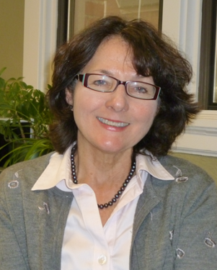
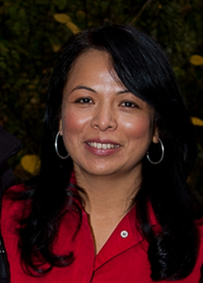
Presenters:
Patricia M Blasco
Associate Research Professor
Teaching Research Institute
Western Oregon University
Director Project PEPI
Rashida Banerjee
Associate Professor of Special Education
School of Special Education College of Education and Behavioral Sciences University of Northern Colorado
Martha Villegas-Gutiérrez
Assistant Research Professor
Teaching Research Institute
Western Oregon University
Notes:
My name is Patti Blasco. I am an associate research professor at the Teaching Research Institute at Western Oregon University. I am also project director of project PEPI. Project PEPI is preparing early childhood professionals for inclusion.
My name is Rashida Banerjee. I am an associate professor at the University of Northern Colorado. We also have a related grant at University of Colorado Denver and University Northern Colorado.
My name is Martha Vilegas-Gutierrez. I am an associate research professor at Western Oregon University.

Slide 5
What We Will Cover
Part 1 – The Basics of Screening and Assessment
Part 2 – Culturally Responsive Screening & Assessment
Part 3 – Screening and Assessment:
When the Native Language is Not English
Part 4 – Final Thoughts About Screening and Assessment
Notes:
Patti: What we will cover today includes screening and assessment particularly for children from culturally diverse backgrounds. Screening and assessment are part of an umbrella evaluation system and they help us determine if a child has developmental delays and needs in terms of services. They also help us to monitor progress if services are required for that child.

Slide 6
Part One: The Basics
Click to continue

Slide 7
Individuals with Disabilities Education Act
I
D
E
A
“Assessment materials are selected and administered so as not to be culturally or racially biased.”
All assessment procedures must be completed in the child’s or family’s “native language.”
Notes:
Patti: It’s important to review public law in terms of how that sets stage for what we will be covering today. The Individuals with Disabilities Education ACT requires that all assessment materials are selected and administered so that they are not culturally or racially biased. It is also important that all assessment materials be completed in the child’s native language.
Native language is that used by the parents of the young child. Sometimes parents speak a different language at home. It is important to ask parents what language is most often used at home. And what language is used with the child. If the child is deaf or hard of hearing, the dominant mode of communication should be used.

Slide 8
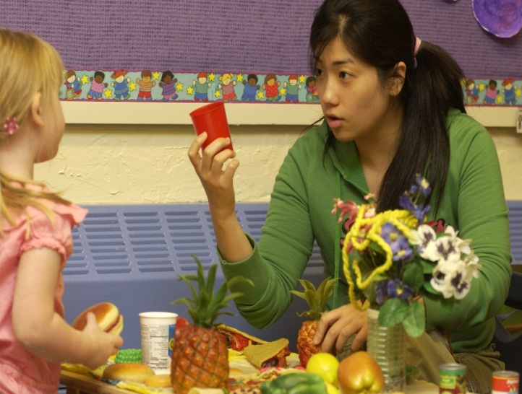
Screening
Brief procedure or instrument
Designed to identify children who may need further assessment
May be:
norm-referenced,
observational,
clinical
Notes:
Patti: First let’s talk about whats the difference between screening and assessment and when we use those terms. The term screening is used to describe a very brief procedure or instrument that usually takes about 10-15 minutes. It is designed to identify within large group of children, those children who may need further assessment. It should not be used as an assessment tool, it’s really a screening. It is saying of this large population of children, I’m going to see which children may need to go on and have further assessment through a screening process.
Screening instruments can be normed reference, in other words they are developed on a large population of children from around the country. They could be observational and clinical types of screening. For example a pediatric well baby visit is an example of a screening observation. The ASQSE; which is the Ages and Stages Questionnaire is a normed reference instrument that uses parent report.

Slide 9
Screening
Brief procedure or instrument
Designed to identify children who may need further assessment
May be:
norm-referenced,
observational,
clinical
Screen for overall development or possible delays.
Not for diagnosis!
Adjust for cultural considerations.
Notes:
Patti: Again, just to go over overall screening is used to document possible delays. It is not used for diagnosis. A child needs further testing before you can make a diagnosis. It also should be adjusted for cultural consideration.
Sometimes we think of screening as a one quick snap shot of the child’s development, so if a delay or concern is suspected then we would make a referral for further testing. So it’s really important to realize screening is just one part of the process. Screening instruments should be completed by qualified professionals who have had some type of training in that particular screening instrument.

Slide 10
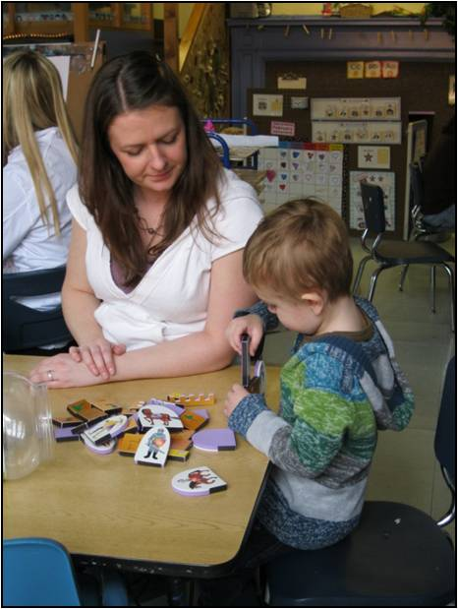
What is Assessment?
5 Domains
Cognitive
Language
Motor
Social/emotional
Adaptive
Notes:
Patti: Assessments provide a longer look at the child development across domains. When we talk about domains we are talking about cognitive, language, motor, social emotional and adaptive. Those are the five domains typically addressed when we look at assessments for young children.

Slide 11
What is Assessment?
5 Domains
Cognitive
Language
Motor
Social/emotional
Adaptive
On-going evaluation
Qualified professionals with family participation
Notes:
Patti: Assessments are also used to do ongoing evaluations of the child as they engage in interventions. Again these instruments should be completed by qualified professionals with the family’s participation. And it’s really important to check on the qualification of the particular assessment you’re using, those are typically in the assessment manual.

Slide 12
Assessment
Information gathered on child’s level of skills and behavior
Determine services
Inform instructional decisions
Document progress
Notes:
Patti: So what exactly is an assessment? Well it’s the gathering of information gathered on child’s level of skills and behavior. They help us determine services. They inform us in terms of instructional decisions and they help us to document progress. So those are the areas that are most important to remember when we’re talking about assessments.

Slide 13
What is the same?
Both screening and assessment instruments must be reliable and valid .
The National Association for the Education of Young Children (NAEYC) and the Division for Early Childhood (DEC)endorse cultural sensitivity when choosing screening and assessment tools.
Notes:
Patti: What is the same about screening and assessments? They must be reliable and valid. There are professional organization such as The National Association for the Education of Young Children (NAEYC) and the Division for Early Childhood (DEC). Both of which endorse cultural sensitivity when choosing screening and assessment tools. You can go their websites and see some information that might be helpful to you.

Slide 14
Assessment
Reliability
Validity
The degree to which an assessment tool produces stable and consistent results
Notes:
Patti: What is reliability? Well a test is reliable when individual differences are measured consistently. For example, if you had all three month olds would respond to that item within an hour range of variability.

Slide 15
Assessment
Reliability
Validity
The degree to which an assessment tool produces stable and consistent results
Degree to which an assessment measures what it claims to be measuring
Extent to which individual differences are measured consistently.
Face: test appears to assess what it is intended to assess
Content: test items correspond to the objectives of the test
Construct: test relates to intended construct (variable such as attribute, ability or skill)
Notes:
Patti: Validity is another term we often use when we are looking at instruments that need to be both reliable and valid. Validity means the degree to which that particular assessment tool measures what it’s supposed to measure. So we often talk about face validity in the fact that if you are looking at particularly an instruments for early childhood, you would expect to see some toys. You would expect to see something that would keep an infants or toddlers attention as well as a young child’s attention.
Face validity really relates does the test look valid to those individuals who are using it.
There is also content validity which is a specific way of measuring the items on the test actually correspond to the objectives of the test.
There is also construct validity which means that the items on the test are related to the overall construct. For example on the Bayley’s scale of infant toddler development there are items that look at memory. So those items would be looked at in terms of construct validity - in terms of how they relate to memory. These are briefly going over things you should know, and what you might want to look for when you are looking at a manual on a certain type of assessment.

Slide 16
Types of Assessments
Norm-Referenced
Curriculum-based
Compares and ranks test takers in relation to one another
Adheres to required protocols, materials and procedures
Based on normative data on children in a particular age range
Measures what the child knows or can do in relation to specific curriculum objectives
Used to teach functional skills based on child’s current knowledge and skills
Notes:
Patti: There are many different types of assessment.
Standardized assessments that adhere to specific protocols, materials and procedures. For example if you’re giving a test that is standardized, you cannot replace a toy and use another toy from a different (test) kit. You have to use the standardized items that come with that particular test kit
These (standardized assessments) are often based on normative data for children in a particular age range. They might be children age one month - they might be age 3 years, but you are definitely looking at a small age range in terms of normative data for each age grouping.
Curriculum based assessment isactually designed to link assessment to a particular curriculum. This often is used to because it’s not based on normative data. You’re not comparing children to a standardized average. You are looking at children in terms of what they can do on a particular curriculum.
Curriculum based assessments (CBAs) are used to teach functional skills and are based on a child’s current knowledge and skills. We often use CBAs with young children with special needs because in that way we look at what is functional for them in terms of what we learn about their present skills. And then we are able to create some activities that are functional for them in terms of the curriculum.

Slide 17
Screening and Assessment
Play-based
Observation
Families and team members observe and record child’s play
Occurs in the natural setting and may cover:
Social Structure
Fine and gross motor
language
Used to gather information about a child’s abilities across domains
Portfolio
Pictures, anecdotal records, media
Notes:
Patti: Other Types of assessment often used include:
play based assessment (PBA) which can involve the team and family together in setting up the PBA. PBA is based on observing a child in their natural setting and recording their play according to areas of play such as the social structure of play and at same time look at fine and gross motor ability as well as language. Again this (PBA) occurs in natural environment and often include routines such as snack.
Observation or checklists of children’s abilities across different domains…Again, domains would be cognitive, language, motor, and social-emotional.
Portfolio: A final type of observation is putting together a portfolio of the child’s work which can include pictures, anecdotal records, and media
These are different types of assessments – instruments you will often see - both screening and assessment out in the field.

Slide 18
Screening and Assessment
Play-based
Observation
Families and team members observe and record child’s play
Occurs in the natural setting and may cover:
Social Structure
Fine and gross motor
language
Used to gather information about a child’s abilities across domains
Portfolio
Pictures, anecdotal records, media
Checklist
Systematic, structured observation
Notes:
Patti: Checklists are another popular form of assessment and can be either screening or assessment tools. A popular screening is the M-CHAT (Modified Checklist for Autism in Toddlers) which looks at children with autism.

Slide 19
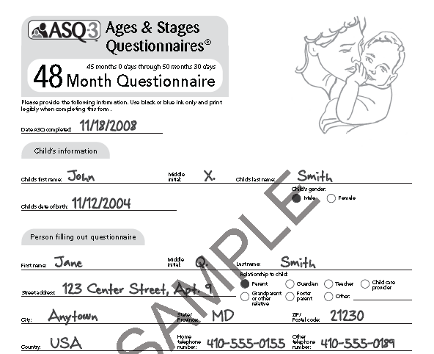
Surveys
Completed by the parent or information obtained from parent by teacher or other professional
Gives a snapshot of the child’s overall development
http://agesandstages.com/pdfs/asq3_english_48_month_sample.pdf
https://asqoregon.com/whatisasq.php?lang=en
Ages and Stages Questionnaire
Click to continue
Notes:
Patti: Children come into a pediatrician and the Ages and Stages Questionnaire is available for parents to fill out in English and in Spanish and I believe in other languages as well, while they are in the physician’s office. There is also an opportunity to fill out the questionnaire online which many parents prefer to do
This is an opportunity for pediatricians to get a quick snapshot of the child’s overall development and then if there are concerns they can refer the child on for other assessments. We gave you the address where you can find more about the ASQ. There is also a Ages and Stages Social-Emotional Questionnaire that’s very popular as well.

Slide 20
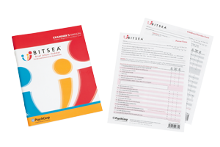
Rating Scales
Have 3 to 5 response stems such as Not Yet, Sometimes, Often
Examples:
Brief Infant and Toddler Social
Emotional Assessment (BITSEA)
http://www.pearsonclinical.com/childhood/products/100000150/brief-infant-toddler-social-emotional-assessment-bitsea.html#details
Infant and Toddler Social Emotional Assessment (ITSEA)
http://www.pearsonclinical.com/childhood/products/100000652/infant-toddler-social-emotional-assessment-itsea.html#details
Click to continue
Notes:
Patti: Other type of instruments that are often used in the field are Rating Scales. Rating Scales usually have a 3-5 response stem such as “not yet”, or “sometimes”, or “often”
An example of that is the Brief infant and Toddler Social Emotional Assessment also called the BITSEA. There is an Infant and Toddler Social Emotional Assessment (ITSEA) . We provided links on the page. They provide information on children in terms of their social and emotional development.

Slide 21
Curriculum Based Assessment Teaching Strategies GOLD
User-friendly and inclusive
Use with any curriculum in early childhood
Fully Bilingual in English and Spanish
Teaching Strategies GOLD offers Spanish language and literacy activities to help teachers scaffold children’s learning in these areas
Notes:
Patti: Now by way of example - one curriculum-based tool is called the Teaching Strategies GOLD. It is a very user friendly and inclusive curriculum-based assessment. It can be used with any curriculum in Early Childhood. It is fully bilingual in English and Spanish and often used in Head Start. It’s very popular in Head Start. So this is a good example of what we might be looking for as an assessment instrument that is actually culturally responsive.

Slide 22
Part Two – Culturally Responsive Screening and Assessment
Click to continue
Notes:
Patti: Now we will transition and I will turn things over to Rashida who will be talking about some tips in terms of culturally responsive assessment. Rashida?

Slide 23
“Critical” Qualities of Assessment
Useful
Acceptable
Authentic
Collaborative
Equitable
Convergent
Sensitive
Congruent
Neisworth and Bagnato (2005)
Notes:
Rashida: Thank you. So Patti really talked about some great ideas around the foundation of assessment. The technical aspects of assessment, what makes a good assessment and what are the examples of assessment.
What I will talk about is basically some of the recommendations of how to make sure you are using the right assessment, and using assessment in a culturally appropriate manner
John Neisworth and Steven Bagnato in their DEC recommended practices talked about 8 different critical quality of assesssment
The first one is Usefulness – it is used for the purpose that the assessment is meant for - for screening or evaluation or for monitoring progress. So, adapting or using the assessment for the purpose.
Acceptability – acceptability refers to whether assessment uses the method and styles that are mutually agreed upon by the team members. So it is acceptable to the entire team as a useful method of assessment
Authenticity – authenticity refers to using the assessment within natural routines and environment. We’re not trying to contrive situations for assessment, especially with young children to perform. Its very hard to get them into a corner and say point to this and point to that. By using play based assessments like Patti discussed earlier..those are authentic assessment methods.
Collaborativeness – collaborativeness refers to using a team based approach to assessment, not one professional sitting with a child and trying to assess a child. Here you’re working as a team across disciplinary or a multi-disciplinary team. With the family members, with the professionals with different backgrounds coming together to complete the assessment
Equitability – equitability refers to the aspect of appropriateness for individuals or accounting for individual differences. This is particularly relevant for the group we are talking about today, children who come from diverse cultural and linguistic backgrounds. Particularly for them we may need to modify some assessment items, to accommodate their needs separately - so individualizations of that assessment tool or assessment method
Convergence refers to the meeting of ideas, meeting of assessment data from multiple professionals. For all assessment methods and tools. So, you may use an assessment tool for gathering data, but that can be supplemented with say Head Start teacher or the parent interview – some of that information…So, gathering data from multiple sources
Sensitivity of assessment refers to the fact that - sometimes children from diverse linguistic backgrounds or children who may have more significant disabilities will not show a huge growth or progression. So the sensitivity of the assessment refers to how well you can see that increment of change in assessment method. So you are being able to demonstrate even the slightest change in the child’s development can be noticed with that assessment method
Congruence refers to the fact that the –materials designed are used with all children and those who may have mild or varying degrees of abilities or linguistic differences. So this term refers mainly around the materials used during the assessment process.

Slide 24
Recommendation #1
Choose the “right” tools and methods of assessment.
Culturally appropriate assessment methods should
allow for professionals and families to collaborate
be developmentally appropriate
provide useful information for goal development and intervention, and
meet legal requirements
Notes:
Rashida: There are multiple recommendations suggested by national organizations such as the American Speech and Hearing Association (ASHA) or the Division of Early Childhood (DEC) or NAEYC. What we are going to talk about are recommendations from these organizations, specifically as they relate to working with children and families from cultural and linguisticly diverse backgrounds.
The first one – choose the right tools and methods of assessment. Culturally appropriate assessment methods should:
allow for professionals and families to collaborate
must be developmentally appropriate: So if the authors or publishers say this assessment should be used for 3 year olds we do not use them for younger or older children than that age group. So, it is developmentally appropriate.
And provide useful information for goal development and intervention: So what is the purpose of assessment unless it can help you in intervening appropriately, it can identify the current level of development and the child’s preferences and interests?
And finally, it must meet legal requirements for assess: Particularly if you’re trying to use the assessment tool for eligibility purposes, determining eligibility for special education. That assessment tool must meet requirements of the state where you are trying to make these eligibility decisions.

Slide 25
Recommendation #1 (cont.)
Choose the “right” tools and methods of assessment.
Given that,
Assessment tools are an expensive investment
Most EI/ ECSE practitioners report that choosing culturally appropriate assessment tools is a challenge
It is imperative that EI/ECSE professionals utilize a team-based approach in selection and use of assessment methods in their programs that
best meet the assessment purpose, and
match their needs and those of children and families they typically assess.
Notes:
Rashida: Given that the purchase of an assessment is a really expensive investment. A number of assessment tools range from anywhere from between $200 to $2000. Given the fact that they are expensive, given the fact that most EI and ECSE report that choosing culturally appropriate assessment tools is a challenge
It is absolutely imperative that EI/ECSE professionals utilize a team based approach in selection and use of assessment methods. So that administrators, child find coordinators, classroom teachers, all of them have a say in what assessment tools and assessment methods are used for children and families. And that these methods and tools must meet the assessment purpose, and match the needs of those children and families that they typically assess. Particularly if you got a varied population from one region then you want look at the assessment tool to make sure that it is normed for that population. The population in Colorado may not necessarily be the same population that you assess in Oregon. And even within Oregon - from the mountainous regions, versus the city-based, urban populations may be slightly different
So choosing assessment that is appropriate for the children and families you serve.

Slide 26
Recommendation #2
Use authentic assessment methods
Assessment of young children and their families must involve identifying environmental, maturational, and social factors that may impact the child’s development and learning
Need for evaluation of the child using an ecological perspective
Notes:
Rashida: Recommendation #2 Use authentic assessment methods. We talked about it earlier.
Assessment of young children and their families must involve identifying environmental, maturational, and social factors that may impact the child’s development and learning. And it must use ecological perspective let’s look at what that means

Slide 27
Recommendation #2
Use authentic assessment methods
Using an ecological perspective in assessment:
Use play based assessment tools/methods that
are developmentally based
take into account child’s prior experiences
allow for observations in natural environments
help in making recommendations and planning next steps with the family
Notes:
Rashida: What does using an ecological perspective in assessment mean?
We must use play based assessment tools and methods that
are developmentally appropriate
take into account child’s prior experiences
allow for observations in natural environments
help in making recommendations and planning next steps with the family
So particularly for young children, there are certain issues that come up when we are assessing young children that may not be as relevant when you are assessing older children.
1.The first is familiarity with the assessor
2. Familiarity with routines. You cannot ask a 3 year old to sit in a corner and spend 20 minutes, 30 minutes on an assessment tool - it’s going to be hard. You not going to get valid or reliable data from an assessment method like that. We must use authentic methods that allow for use in natural environments and routines

Slide 28
Play-based Assessment
Look at these brief play-based assessment clips. Ask yourself:
Are the child and family engaged?
Can developmental assessment information be gathered?
Does this look natural?
http://www2.cde.state.co.us/media/resultsmatter/RMSeries/CaulPlaysWithAPuzzle.asp
http://www2.cde.state.co.us/media/resultsmatter/RMSeries/HenryAtMealtime.asp
Click to continue
Notes:
Rashida: So here are some videos about play based assessment. Take a look at these brief clips and think about these 3 questions
Are children and family engaged in this assessment?
Can developmental assessment information be gathered through these assessments?
Does this look natural to you? Look natural in the sense, is this a contrived situation or is this what the child would typically do in any other environment as well.

Slide 29
Recommendation #3
Develop culturally relevant assessment procedures from a home language and culture framework
use multiple sources of information that converge to form a determination of disability and eligibility for services
Families perspectives are a critical source of information.
Ethnographic Interviewing (Westby, Burda, & Mehta, 2003)
Routines-Based Interview RBI (McWilliam, 2006)
Notes:
Rashida: For Recommendation #3 “develop culturally relevant assessment procedures from a home language and culture framework
What do we mean by this – culturally relevant assessment procedures?
Specifically, always use multiple sources of information that can merge to form a determination of a disability, or help you understand the next step in the child’s development.
As a part of multiple sources, when we talk about multiple sources we’re talking about multiple people and multiple methods in terms of observation assessment tools, interviews, etc.
These (family perspective) are a critical source of assessment and information.
Carol Westby talks about Ethnographic Interviewing (we talk about this in the next slide)
The other important source for gathering family perspectives through routines is Robin McWilliams Routines-Based Interview (RBI). What this assessment tool does at RBI is walk the family through different routines and there are certain questions along the way that you ask the family. The family provides you with information - whether it is it a good fit, whether there are some challenges, whether the routines are working well. And that helps you to develop the goals in your next phase.

Slide 30
Westby’s Ethnographic Interviewing
Developing Rapport
Restate what parent says
“Tell me more…”
Grand-tour questions
Open ended questions
Notes:
Rashida: In Westby’s Ethnographic Interviewing, what you do is initially start with developing a rapport with the family members and then ask “grand tour” questions such as tell me about what a typical day looks like. And then you ask very specific questions where you want to probe a little bit more -
“So you say that feeding is a challenge with Jose. Can you tell me a little bit more about that challenge - what is challenging about that routine.”
And you will also talk about – “Yes I understand that it is a challenge when you say there is a problem in that he doesn’t want to eat enough or doesn’t sit at the table. You’re restating what the parent is saying - reframing that and restating that or asking them to tell you more about hat information.
Always use open ended questions when you’re communicating with the family during assessment. (Rather than) questions that they answer with yes or no.

Slide 31
Family Perspectives
These formats also allow the families to insert their developmental priorities and perspectives into the assessment framework, transforming the evaluation process into a culturally relevant experience for the family and the child.
Notes:
Rashida: Family perspectives – these formats of what the ethnographic interviewing and routines based interview (also allow the families to insert their developmental priorities and perspectives into the assessment framework, transforming the evaluation process into a culturally relevant experience for the family and the child).
We’ll talk a little more about it when we talk about family participation – what we mean about this phrase.

Slide 32
Recommendation #4
Effectively use interpreters and develop the role of a cultural mediator
A cultural mediator is an individual who helps interpret language, but even more importantly, the cultural mediator translates between the culture of the environment in which services are provided and the child’s family to produce understanding, share information, and create relationships between the family and the interventionists.
(For more information, see Perez-Mendez & Moore, 2005)
Notes:
Rashida: The next one is relevant for the group we are talking about – families from linguistically diverse backgrounds, particularly families who do not speak English or the primary language of the provider or assessor.
So, “Effectively use interpreters and develop the role of a cultural mediator.”
Perez-Mendez and Moore provide a great excellent strategy in how you do this.
The use of the word “cultural mediator” versus somebody who is just a translator.
(A cultural mediator is an individual who helps interpret language, but even more importantly, the cultural mediator translates between the culture of the environment in which services are provided and the child’s family to produce understanding, share information, and create relationships between the family and the interventionists).
So what That mean is that a cultural mediator is more than a translator. They also provide the cultural context for that conversation …both for the family and the team of assessors - the professional team. Lets look at examples on the next slide.

Slide 33
Recommendation #4
Effectively use interpreters and develop the role of a cultural mediator
EI/ECSE practitioners need to develop strategies for working with interpreters and cultural mediators
access well-trained and bi-literate interpreters
develop a team approach with the interpreter
plan before sessions and debrief afterward
Notes:
Rashida: Early interventionists and ECSE practitioners need to develop strategies for working with interpreters and cultural mediators.
First, access well-trained and bi-literate interpreters. Very often the practice is “find someone who’s a paraprofessional, the office secretary, who probably knows the child’s family language. Here we’re talking about recommendation that people who will be translating have to be well trained in this process. When we utilize interpreters who are not trained in the process - siblings sometimes, we are going to lose validity of information in
the information in the process.
Develop a team approach with the interpreter. Consider the interpreter as part of the professional team of SLP speech language pathologist or occupational therapist, early childhood teacher and the family. The interpreter is part of the team, part of the team discussion from beginning to end. Even from the time we start identifying a time for the assessment process.
Working with interpreter definitely takes extra time. So plan before the session how the interpretation is going take place. We will talk about that on the next slide- the different forms of interpretation.

Slide 34
Recommendation #4
Effectively use interpreters and develop the role of a cultural mediator
Know the type of interpretation that will be needed:
Simultaneous translation
Summarizing translation
Have specialized training in working with interpreters and cultural mediators
Plan for extra time before, during, and after the meeting
Notes:
Rashida: Whether you are going to be doing the simultaneous translation or summarizing translation.
What simultaneous translation is - you talk as a professional, the interpreter simultaneously translates the same information for the family. Similarly when the family talks or says something, the interpreter simultaneously translates that information for the English speaking professional team.
Summarizing translation - you as the professional talk, the interpreter summarizes that for the family, the family responds, the interpreter summarizes that for professional - so there is a lag time in between that.
Both of them have advantages and disadvantage,s but it’s important for both family member and interpreter and the professional team to understand that what is the message going to be so you can plan for that time appropriately and you can give that wait time to the family and the interpreter along the way.
Pattie: I would add as an example that often times what may happen, particularly when you do have tests that require a certain protocol. For example, you might have a test that requires you to ask the child “Show me the little ducks” and the interpreter might say to the child in the native language, “Show me the baby ducks.” That’s a difference.
So often times if you haven’t planned ahead and talked over the type of test you are doing and you’re using simultaneous translation, you need to clarify ahead of time that you need to use the exact words I’m are using. And sometimes when I work with the interpreter they will say to me “I don’t have a word that fits there” or “Is it okay if I use this word instead?”
And so, that’s something again that takes planning. Again, it makes it easier when you use more play-based or curriculum-based assessment. Because then you are able to use more summarizing or more ability to switch out words that maybe fit better in a particular language. Does that make sense?
Rashida: Absolutely, thank’s Pattie. I had not touched on that. So even the interpretation for the child may be doing that. That’s important to realize that with the family adult it’s a different level of skills that you would need versus when you’re interpreting or translating information for the child.
Then because once you translate, the validity (especially of a norm referenced instrument) the validity of the instrument is compromised. One method in looking for assessment tools - when you talk about the right assessment tools - look for assessment tools that might have the translation. The M CHAT, that we talked about earlier - that is translated into multiple different languages. The Ages and Stages Questionnaire (ASQ) has been translated in multiple different languages. That is a consideration when looking for the right assessment tools as well.
Patti: Totally, that’s an excellent point.
Rashida: The Professional not only should know who to interpret, (and) not only should the interpreter have training - as professionals we must have training in working with interpreters and cultural mediators related to some of the skills we talked about. And the fact that you need extra time before, during, and after the meeting for debriefing as well.
Professionals and interpreters - you can give each other feedback about what went right and what did not, so that next time you bring that interpreter in, you can do it differently so it is more useful for the family. The family may come in at the debrief time to say what went right and what did not. That is separate from the assessment situation - that is a debrief of how the interpretation and translation went.
Martha: Can I make a recommendation for working with interpreters? I always recommend for interpreters to be bi-cultural or be knowledgeable and familiar about the child’s and family’s culture.
Rashida: Especially as the role of cultural mediator to have that familiarity. Thank you.

Slide 35
Recommendation #5
Include parents as partners in the assessment process
As per IDEA, families have the right to actively participate in the evaluation, assessment, and program planning of their child
Parents know their child best
Active parent involvement may aid in addressing challenges associated with understanding linguistic development in children from CLD (Culturally and Linguistically Diverse) backgrounds
Notes:
Rashida: Recommendation #5: include parents as partners in the assessment process. IDEA – Individuals with Disabilities Education Act, certainly gives the family rights to actively participate in evaluation, assessment and program planning and requires that professionals identify ways in which families can actively participate.
The important thing is that the family knows the child best so therefore we have to bring the family in during the assessment process. We only have a small window to learn about the child as professionals. Active parent involvement may also aid in addressing the challenges associated in understand the linguistic development in the child from a CLD background.
S what we are recommending here, is that whenever we assess children to not assess the child in isolation away from the family. Assess the child the with family so we can get a complete picture of the child.

Slide 36
Recommendation #5
Include parents as partners in the assessment process
Role families can play during evaluation:
Parents can guide the evaluation to be based on specific concerns they raise
Parents may act as play facilitators
Parents may interpret child’s behavior
Parents may validate whether or not the child’s behavior during assessment is typical of an average day.
Notes:
Rashida: When you are working with families - what are the roles that the families can play during assessment and evaluation? Parents can tie the evaluation to be based on specific concerns they have. So if the parents say “I’m concerned about feeding,” then it guides the evaluation assessment tool that way. Or if the parent says” I am really concerned that Jose does not listen to me,” or “Narnia doesn’t listen to me and I am having a hard time getting clothes onto her.” They can look at some of the education issues that the child may have so you can delve into those events more specifically.
The other area, the parents may act as play facilitators. Because children may not be familiar with us they are unlikely to demonstrate their real skills with us. The parents can play with them and you can say, “Can you show me how he plays with you?” And the parent says “He does a nice job. He loves his train and he’s always playing with his train.” You can come in and say “Can you show me how he does that or how you play with him?” Play facilitators.
Parents may interpret the child’s behavior. If the child is touching his chin and the parents may say “Oh, this means that he is bored now. He’s all done.” So the parents can help you interpret the child’s behavior. Or when the child flings his hands in the air they may say “the child is hungry and that is what he is trying to say show you, that he is hungry and needs some food.” So you can understand the child’s behavior, especially for a younger child who will not be able to verbalize their behavior as much.
Parents may validate whether or not the child’s behavior during assessment is typical. If it’s not typical, we need to find other methods or ways to find what the child can typically do to get valid and reliable assessment information. And so our goals that we develop based on the assessment are also authentic and appropriate for the child and family. Otherwise we will be developing inappropriate, inaccurate goals and intervention later if we do not have a clear assessment baseline.

Slide 37
Recommendation #6
Present evaluation results in a clear, family-friendly, and culturally sensitive manner
Mind your body language
Effectively use interpreters- give enough time for family to process the information
Provide a written report
Reporting language [verbal or written]:
Jargon free
Family friendly
Sensitive
Meaningful
Notes:
Rashida: Recommendation #6. One of the important things that professional do not do as well when professionals are conducting assessments - families also need to know what the assessment results are. And in a study that I conducted with a colleague, this came up as one of the top challenges that professionals face in the field.
How do you share results with families from an assessment? Not just with families who are from culturally and linguistically diverse backgrounds, but overall. Therefore it becomes even more challenging when you try to share with results with the use of an interpreter or trying to talk across cultural diversity as well as cultural barriers.
The other thing is - how do you share results in a clear family friendly and culturally sensitive manner.
Mind your body language. How you say and what you say are particularly.
When you are presenting results, make sure you are reporting facts. Not our interpretation beyond some of those facts and events. Not something that suggests judgment in that regard. For example, we can say “Lena now knows about 20 words. But children at her age typically know 50 words.” That is a fact representing. Instead of saying Lena is really, really delayed in her language development. So some of those language how we share results
Effectively use interpreters. Give enough time for families to process the information, especially at the time of the result sharing. We need to give families more time than what is typical also so they can process information and ask questions accordingly
Provide a written report. Even if you cannot translate the report, always return the report so families can go back and read the report and come back with questions they might have.
It’s a long time for the family when you are conducting the assessment. The family may be stressed over the information. So giving them enough time to go back with the written report, get it read by somebody if they need to. Get it discussed with somebody else, other family members. That may be useful for them. Always provide a written report.
Reporting language whether we use verbal or written - It must be jargon free. It must be family friendly, sensitive to the family cultural needs and linguistic needs and it must be meaningful.
Avoid any information that is not relevant to assessment that you have conducted and is not relevant to what is going to happen next.

Slide 38
Recommendation #6
Present evaluation results in a clear, family-friendly, and culturally sensitive manner
Cultural interpretation of disabilities
Some cultures view developmental delays and disabilities differently than European American culture
Spiritual interpretation: Divine gift from God
One disability category may be interpreted for another disability
Notes:
Rashida: Also when reporting results what do we mean by culturally sensitive. Some cultures view developmental delay and disability differently from European or American cultures. There may be a spiritual interpretation to how they view disability. Some Asian cultures view disability as something they did in a previous (?) and so it’s a result of that. Or it can be a divine gift from god. It can be either way the interpretation of disability.
The other thing is when you discuss disability in a particular category, it may be interpreted as another disability. For example, you may say the child is delayed in speech and language development. Parents may interpret that as delay in cognitive or intellect. So try to be clear about what you say to the family and how they interpret it.
Check for their understanding along the way as well.
Pattie: On this particular point. I thought this was an excellent point, because often times we need to go back and talk with families about our recommendations to make sure that they clearly understand the suggestions that we make or any kind of diagnostic information that we share with them to clarify that they understood that.
Martha you often write reports for parents. I thought you might want to add information from your own experience in writing reports for families of young children
Martha: You know with regard to writing reports, I do include all the information and make it a language based…not technical so parents can understand it. So its parent friendly.
I like to back up to the point you made about allowing parents enough time to process the information. Usually when parents already know there is something going on, they are relieved to listen to the results. However, it has also been my experience that parents who have no idea what’s happening with their children, they need time and not just the session for results. But time to process the info. I always encourage them to call me back because I know they will have questions later on in a couple of days and they do. That was the recommendation I wanted to make with regard to giving the family time to process the information.

Slide 39
Part Three – When the Native Language is not English:
Click to continue

Slide 40
Collaboration
So, overall, here are some tips for making sure the instruments you use are culturally responsive.
Screenings and Assessments work best when everyone contributes -- families, professionals, and advocates.
Notes:
Martha: Screenings and assessments work best when everyone contributes – families, professionals, and advocates. So overall, here are some tips for making sure instruments you use are culturally responsive.

Slide 41
Screening and Assessment – Native Language is not English
Examine own bias and assumptions to understand how assumptions can interfere with assessment.
Determine ahead of time if an interpreter is needed.
Try to find an interpreter with experience in early childhood or a parent of young children.
Notes:
Martha: Screening and assessment when the native language is not English. We need to examine our own bias and assumptions to understand how assumptions can interfere with assessment.
We also must be aware of our own training and expertise and limitations. We need to determine ahead of time if an interpreter is needed. And ensure that the interpreter has the expertise of working with culturally and linguistically diverse preschoolers and families. Also, try to fine an interpreter with experience in early childhood or a parent of a young child.
Patti: Just to relate that I wanted to go back to cultural mediators. Often times cultural mediators are persons within a community that have worked with parents and young children. They might not have expertise in early childhood, but their expertise is really working within that community and understanding the cultural needs of that family within the community as well as to help you understand what is valued and what might be difficult for that particular family.

Slide 42
Helpful Professionals
Working with a cultural broker, or trained and experienced interpreter who understands the family's language and culture can help you choose the right evaluation tool by understanding how:
language acquisition,
acculturation, and
socio-economic status can impact the outcomes.
Notes:
Martha: It is important to work with a cultural broker or a trained and experienced interpreter. This person understands the family’s language and culture and facilitates selecting the appropriate evaluation tool because they understand how language acquisition, acculturation, and socio-economic status can impact a student’s performance and outcomes.
Patti: yes very much so.

Slide 43
Communicative-Linguistic Dimensions
Language of the child’s primary caregiving environment.
Child’s relative language proficiency in all languages used.
Patterns of language usage in child’s primary caregiving environment(s)
Verbal vs. Nonverbal Language value and preference
Explicit and Implicit status associated with monolingualism and bilingualism
Barrera, I. & Corso, R.M. (2003) Skilled dialogue: Strategies for responding to cultural diversity in early childhood. Baltimore, MD: Paul H. Brookes.
Notes:
Martha: Assessing the linguistic dimension should focus on five areas according to Barrera.
1. First we look at the language of the child’s primary caregiving environment.
2. Then we look at the relative language proficiency in all languages used. Can the preschooler understand and speak both languages equally or is one language better developed
3. Patterns of language usage in child’s primary caregiving environment(s) Are children allowed to express themselves and use a language or are they expected to listen
4. Language value and preference that are communicated verbally and nonverbally. Nonverbal includes body language, proximity, and context. Body language also refers to gestures, touch, eye contact and gaze.
Pattie: this can be different in different groups
Martha: definitely.
5. Explicit and implicit status associated with monolingualism and bilingualism. Is bilingualism considered an asset or a risk?
Pattie: So, Martha, when you say bilingualism is an asset or risk, what do you mean?
Martha: What I mean is…is the family endorsing bilingualism and promoting it in their children. Or do they feel threatened that if they speak two languages they’re not going to learn English and be proficient in English and therefore not successful.

Slide 44
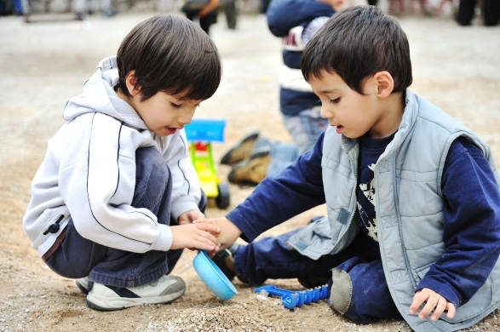
Individual Differences in English Development
“Each child’s way of learning a new language should be viewed as acceptable, logical, and part of the ongoing development and learning of any new language.”
Silent period
Conversational skills acquisition but not truly proficient
Conversational proficiency (receptive and expressive)
Notes:
Pattie: Lets talk a little bit about language proficiency.
Martha: When assessing language proficiency in preschoolers, we need to understand that they go through different stages. The first stage is the silent period. Just like any bilingual students learn a second language, they tend to just watch and observe and not communicate in the second language. It is important to understand that they go through this stage, because many times it is confused as a disability or a language disorder when in fact it is just a natural stage in the second language acquisition process.
After that, Jim Cummins talks about conversation skills and cognitive and academic proficiency.

Slide 45
Language Proficiency
Basic Interpersonal Communication Skills (BICS)
Conversations with friends during play
Verbal interactions with teachers
Informal interactions with parents or friends
One to three years to reach conversational proficiency.
(Cummins, 2004)
Notes:
Martha: Cummins coined the acronym BICS which is Basic Interpersonal Communication Skills which refers to conversations with friends during play, verbal interactions with teachers - basically informal conversations. It usually takes one to three years to reach conversational proficiency.

Slide 46
Language Proficiency
Cognitive Academic Language Proficiency (CALP)
Ability to use and understand complex linguistic meaning in verbal or written communication.
Five to seven years on average, to reach peer-appropriate grade norm levels (Cummins, 2004).
Notes:
Martha: CALP, Cognitive Academic Language Proficiency refers to the ability to use and understand complex linguistic meaning in verbal or written communication. Such as understanding a class lecture, writing an essay. It usually takes five to seven years on average to reach peer-appropriate grade norm levels.
Pattie: So Martha, just define what you mean by peer appropriate grade levels.
Martha: Basically compare them to similar age peers from similar cultural and linguistic backgrounds.

Slide 47
Considerations
Language Acquisition: Pre-schoolers’ knowledge and learning is based on the language spoken at home.
Home language and Children’s culture communicate traditions, values, and attitudes.
Encourage parents to use and develop children’s home language to enhance children’s learning and development.
Notes:
Martha: It is important to consider the following language considerations.
Language Acquisition: Pre-schoolers’ knowledge and learning is based on the language spoken at home.
Home language and Children’s culture communicate traditions, values, and attitudes.
We need to encourage parents to use and develop children’s home language to enhance children’s learning and development.

Slide 48
Acculturation
The process of adaptation to a new cultural environment without abandoning native cultural values.
Cuellar & Paniagua, 2000
Notes:
Martha: Acculturation refers to the process of adapting to a new cultural environment without abandoning native cultural values. It influences family and social interactions as well as cognition, emotion and behavior, perceptions, ideologies, beliefs, values, language use, and other aspects of human behavior and functioning. For young preschoolers from diverse cultural backgrounds, the acculturation level is usually similar to that of their parents. It is important for parents and educators together to promote healthy acculturation outcomes.

Slide 49
Level of Acculturation
What is the families cultural identification?
How long has the family resided in the United States?
How often does family associate with members of mainstream culture?
How often does family associate with members of native culture?
What language does Family/child prefer to use to communicate?
Cultural perspective regarding their preschooler's development
Notes:
Martha: Assessing family’s cultural acculturation level requires you to:
Find out about the families cultural identification?
Time of residency in the United States
Frequency of association with members of mainstream culture
Frequency of association with members of native culture
Language the family and child prefer to use communicate
The family’s cultural perspective regarding their preschooler's development

Slide 50
Family SES and Education
Parents’ education level to help them understand their preschooler's developmental process and needs.
Parents’ socioeconomic status to evaluate their access to community resources to connected them with needed services.
Notes:
Martha: The family’s socioeconomic status is important for both education and intervention purposes. This is true because it reflects directly on their access to resources that promotes and supports healthy development for their children.

Slide 51
PACER Center
Parent training and information center
http://www.pacer.org/ec/
Click to continue
Notes:
Pattie: One of the great resources that I often use is from PACER (Center) located in Minneapolis.
They do have some really wonderful materials on working with cultural mediators as well as interpreters. That’s a resource that may be useful for college professors and students that are viewing this webinar.

Slide 52
Part Four – Final Thoughts and Resources
Click to continue

Slide 53
Use Multiple Instruments
When assessing a child, using multiple measures will help insure that you are getting accurate information:
Use Informal observation
Standardized assessment
Curriculum-based assessment
Play-based assessment
Notes:
Martha: When assessing a child, using multiple measures will help insure that you are getting accurate and reliable information. You may use:
Use Informal observation
Standardized assessment
Curriculum-based assessment
Play-based assessment

Slide 54
Authentic Assessments
Emphasizes functional assessment (measures skills necessary for the child to succeed in everyday situations)
Measures the child’s abilities across natural environments during routines in the home, preschool or child care setting, and in the community
Notes:
Martha: Authentic assessment
Refers to emphasizing functional assessment (measures skills necessary for the child to succeed in everyday situations)
Authentic assessment measures the child’s abilities across natural environments during routines in the home, preschool or child care setting, and in the community

Slide 55
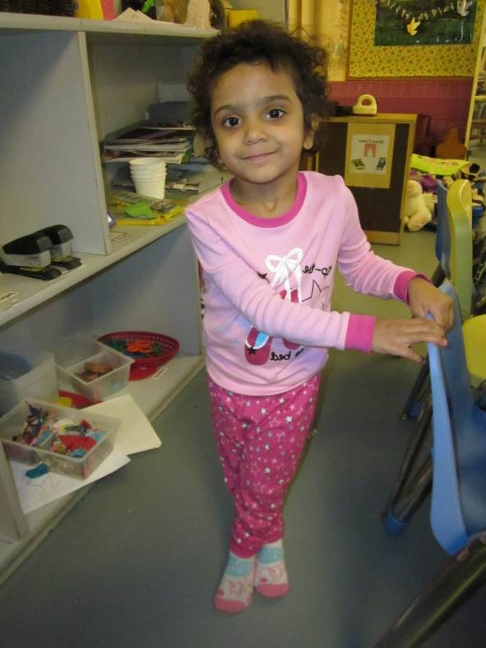
Developmentally Appropriate Assessment
Considering what will make sense to a child given his or her linguistic and cultural background (e.g., avoiding materials that will not be understood).
(Coppel & Bredekamp, date)
Notes:
Martha: Development appropriate assessment: Considering what will make sense to a child given his or her linguistic and cultural background (e.g., avoiding materials that will not be understood).

Slide 56
Developmentally Appropriate Assessment
Interpreting a child's behavior in light of the social and cultural contexts in which the child lives (e.g., not taking a limited verbal response to the test situation to mean he or she is deficient in language or intellect.
Notes:
Martha: When we talk about developmentally appropriate assessment, we refer to Interpreting a child's behavior in light of the social and cultural contexts in which the child lives (not taking a limited verbal response to the test situation to mean he or she is deficient in language or intellect). In such a case you would ask around, ask a teacher or a parent to clarify if what you are getting is accurate.

Slide 57
Recommended Instruments
Screener -- Ages and Stages Questionnaire (ASQ-3 & ASQ:SE) http://agesandstages.com/
Screener -- MacArthur-Bates Communicative Development Inventories
http://www.sci.sdsu.edu/cdi/cdiwelcome.htm
Assessment -- Assessment, Evaluation, and Programming Systems for Infants and Children (AEPS)
http://www.aepsinteractive.com/
Assessment -- Devereaux Early Childhood Assessment Program (DECA)
http://www.kaplanco.com/product/41009/the-devereux-early-childhood-assessment-deca-kit?c=17|EA1000
Notes:
Patti: These are recommended instruments that were on the CLASS – the Cultural-Linguistic Assessment website that is no longer being updated, however they offer the instruments that we have reviewed. That included the Ages and Stages Questionairre), the Assessment Evaluation and Programming Systems, and the Devereaux Early Childhood Assessment Program. These are tools that have been reviewed and are considered to be culturally and linguistically sensitive or responsive to young children.
Rashida: I will add one more - Communication Developmental ASQ 3 that’s a screener as well and that’s used frequently and translated into multiple languages. Especially because we’re looking at communication skills of the child. That’s a great tool to look at the language development as well.

Slide 58
Recommended Instruments
The Creative Curriculum Developmental Continuum
www.teachingstrategies.com
High Scope Preschool Child Observation Record (Infant-Toddler COR, Preschool COR, Early Literacy ELSA)
www.highscope.org
Pre-school Observation – Screening for Hispanic Children
Home Literacy Activity Questionnaire
Helping Your Child to Read
Kayser, H. (2008). Educating Latino preschool children. San Diego, CA: Plural.
Click to continue
Notes:
Patti: And the Creative Cuss is also one that has been rec. And Martha I believe you also have several you are interested in sharing
Martha: Yes, I have three more that were developed by Hortencia Kayser, she’s a bilingual, bicultural speech language pathologist and the author of Educating Latino Preschool Children.
The three instruments are:
Pre-school Observation – Screening for Hispanic Children
Home Literacy Activity Questionnaire
Helping Your Child to Read

Slide 59
Thank you and goodbye
Click the link if you want to learn more about the M-CHAT.
https://www.m-chat.org/
*Neisworth and Bagnato (2005)
Notes:
Patti: I would like to thank Rashida and Martha for their wonderful contributions to this webinar. Thanks so much you guys, this has been great. We also hope you will use this information as you go on with your EC coursework and as well with your work with all children out in the field. Thanks again and have a great day. Bye.

